Slide 1
Introduction to Orleans
Reuben Bond

Slide 2
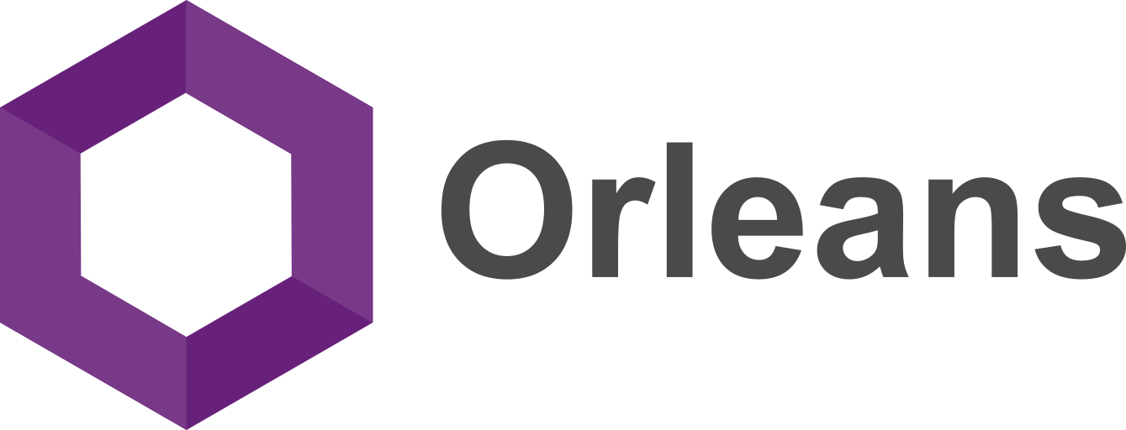
Notes:
Orleans was conceived as a framework to meet modern workloads with cloud native applications

Slide 3
Agenda

Slide 4
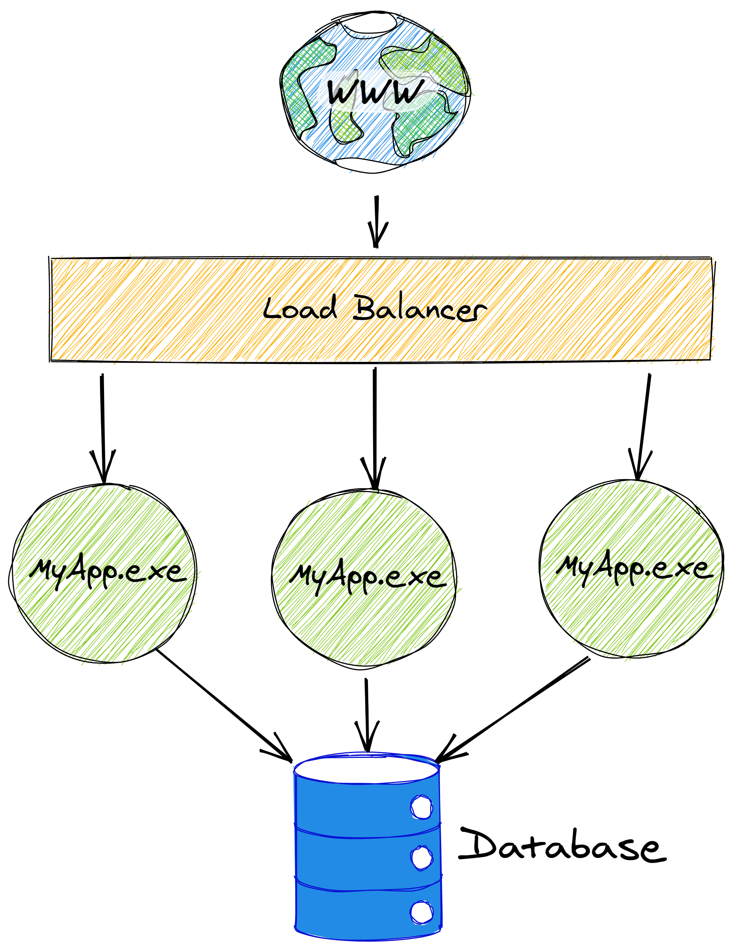
Notes:
Typical app architecture.
Web -> LB -> App -> DB
It’s a popular app, so multiple instances to handle the load as well as for redundancy – we don’t want any downtime.
But we have a problem. The database is slow and our app is read-heavy, so it ends up putting a lot of load on the database.
What’s more, whenever we need to write to the database, our different app instances don’t

Slide 5
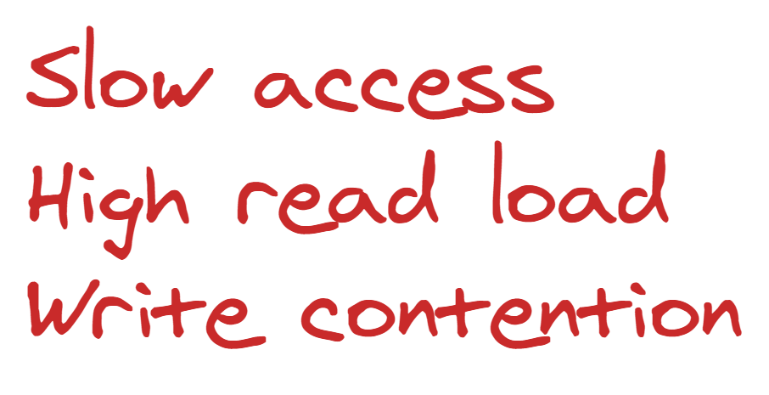
Notes:
But we have a problem. The database is relatively slow and our app is read-heavy. Those reads can end up putting a lot of load on the database.
What’s more, our writes start hitting contention on the database because we have multiple app instances issuing writes to the same rows.
The database becomes contended and starts slowing down even more as transactions have to wait for one another, or optimistic concurrency writes have to be retried by the app instances when they hit conflicts.

Slide 6
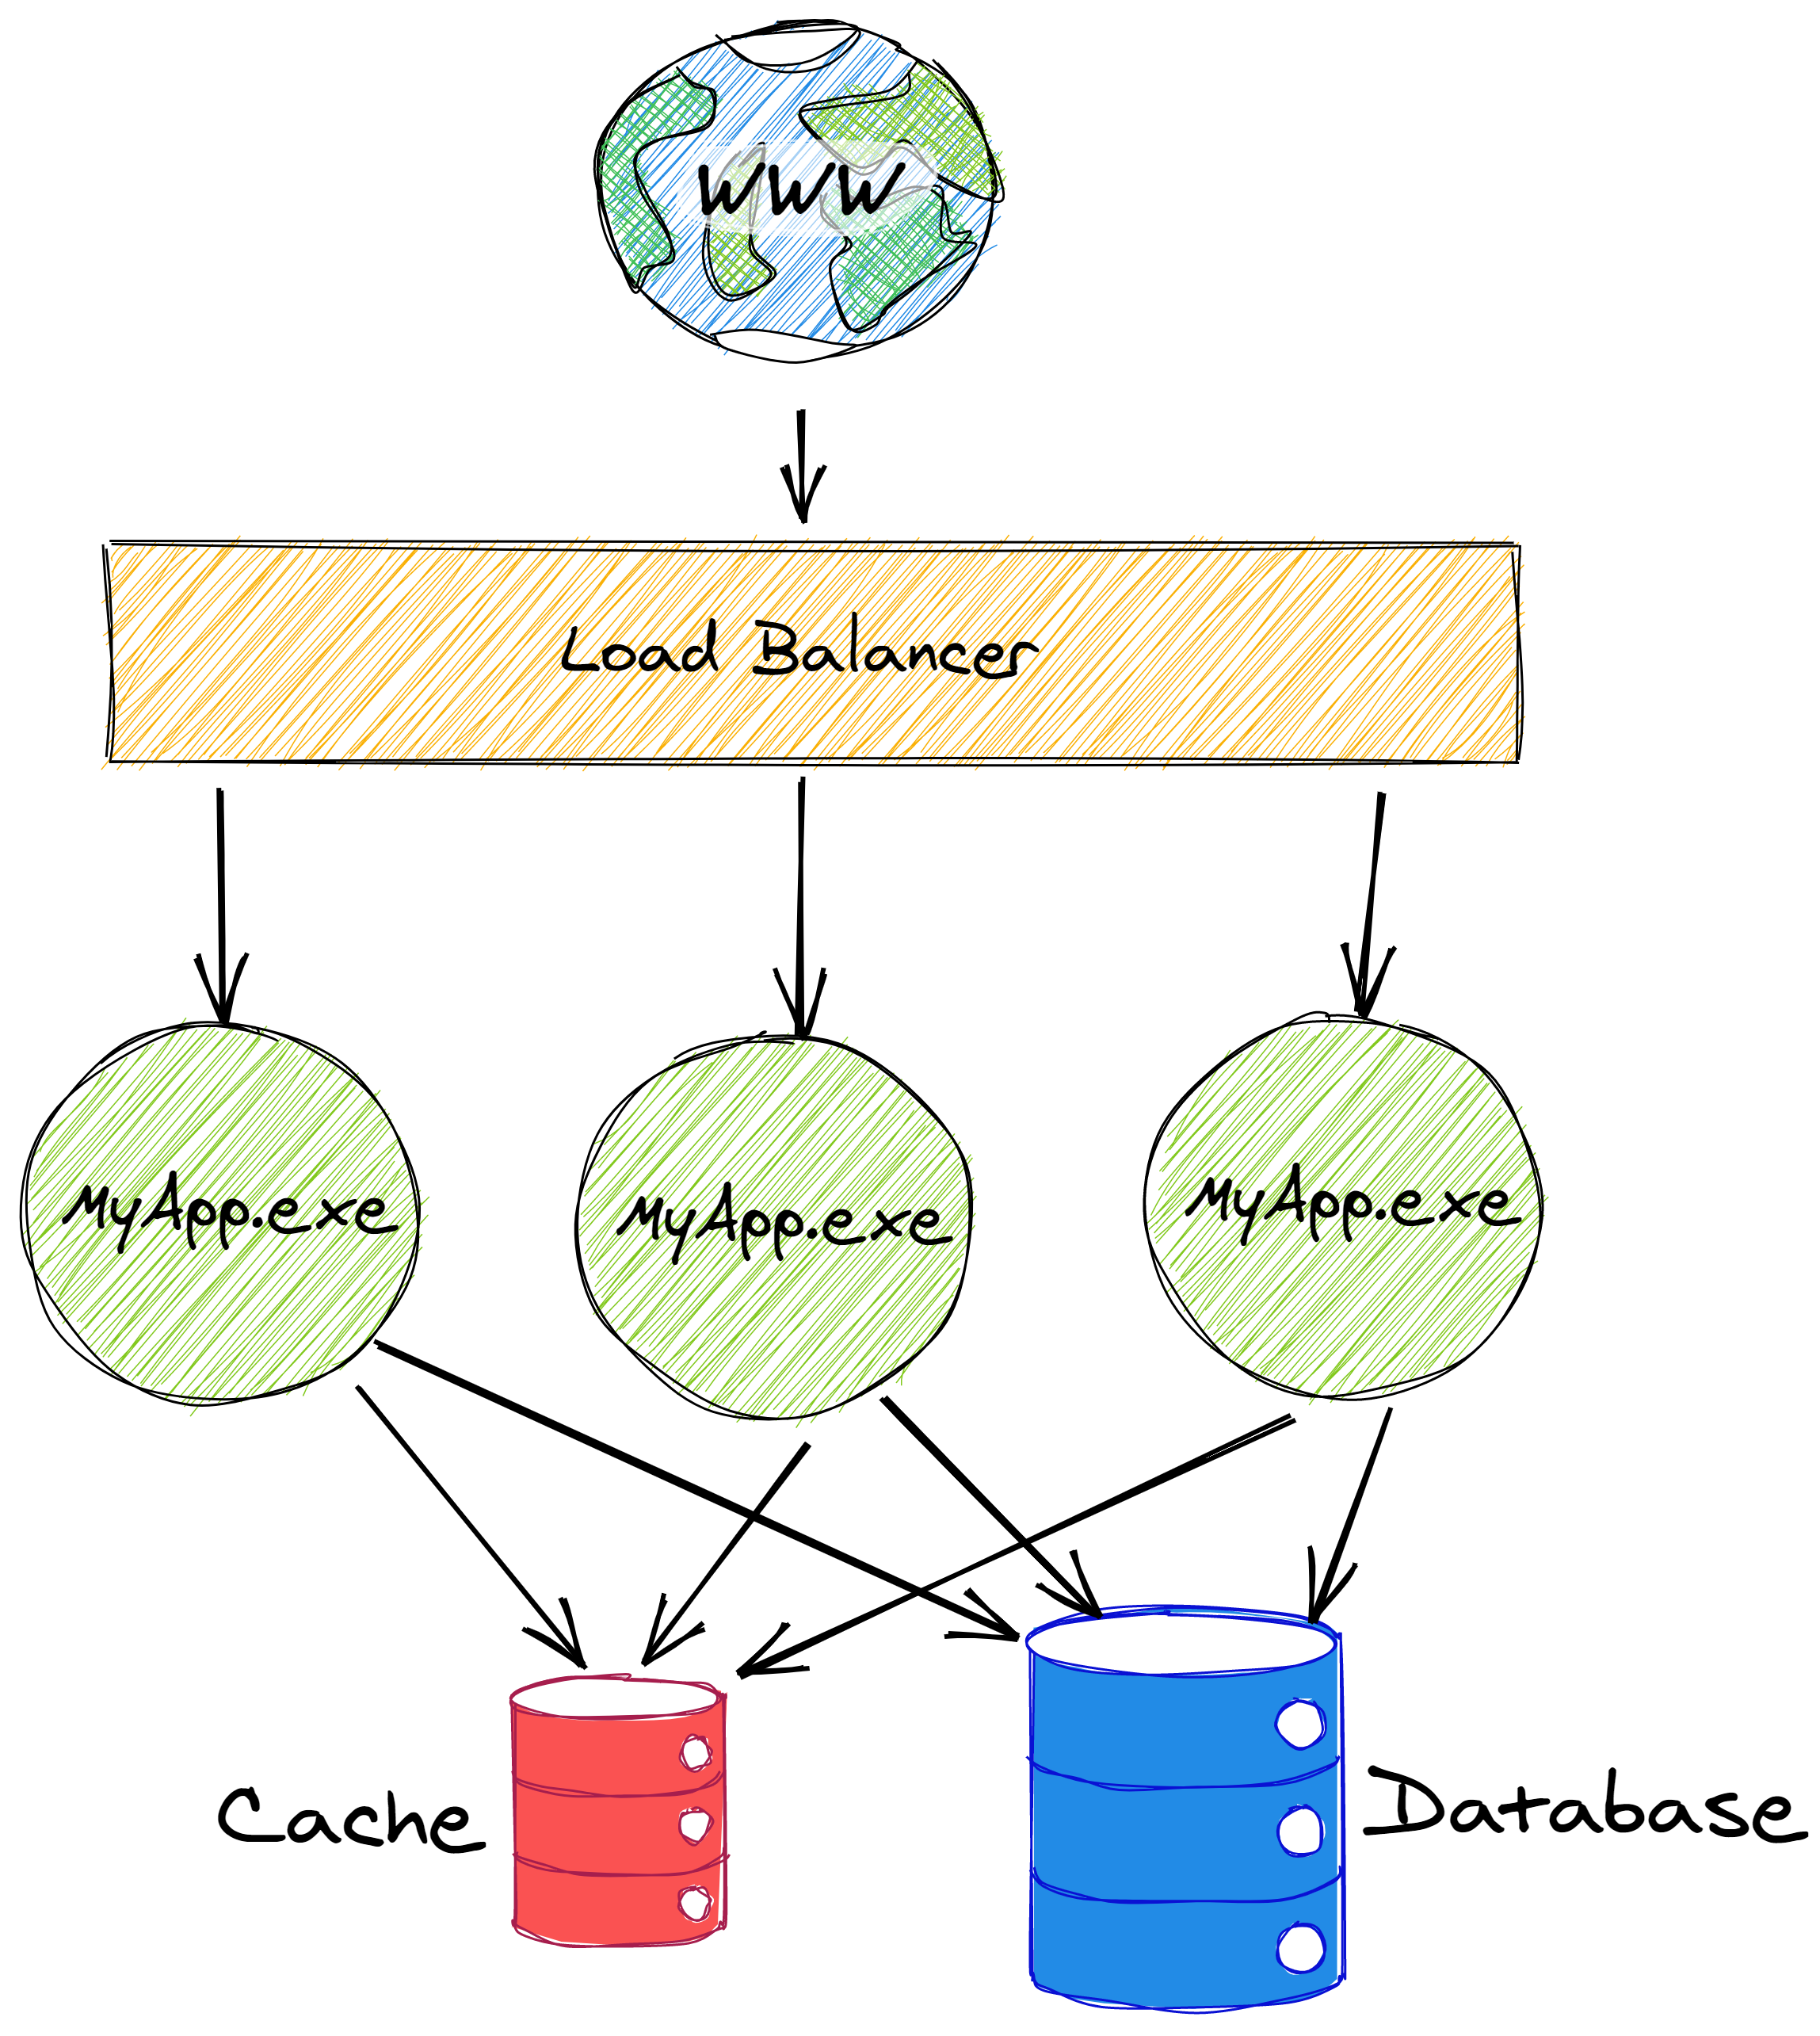
Notes:
Tackle the slow read access by adding a cache. That works for reads, especially for data that doesn’t change much.
When our app wants to update something, it reads from the cache, modifies the value, and writes it back to both the cache and the database.
If the data isn’t in the cache, we read it from the database first.
But there are problems here, too.

Slide 7
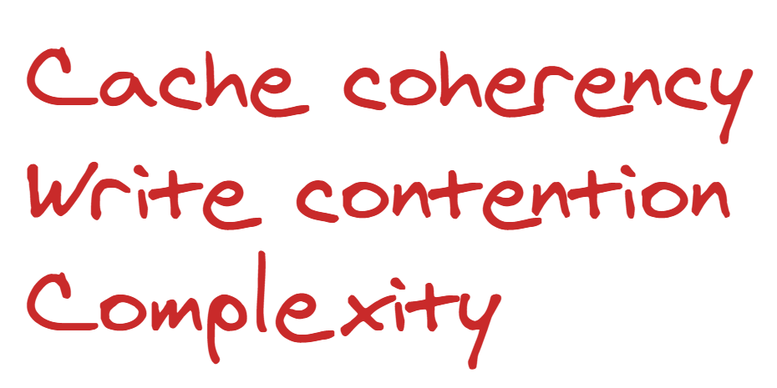
Notes:
There’s a popular saying that there are 2 hard problems in Computer Science:
Naming things,
Cache Invalidation,
Off-by-one errors
Now that we have a shared cache, invalidation is now a problem for us.
So there’s a lot of extra complexity in our app code as well as all of these cache coherency issues.
Also, now we have another dependency which can become inaccessible, so our application can become less reliable as a result.
We still haven’t solved the problem of write contention. So let’s add a queue to try to alleviate that contention.

Slide 8
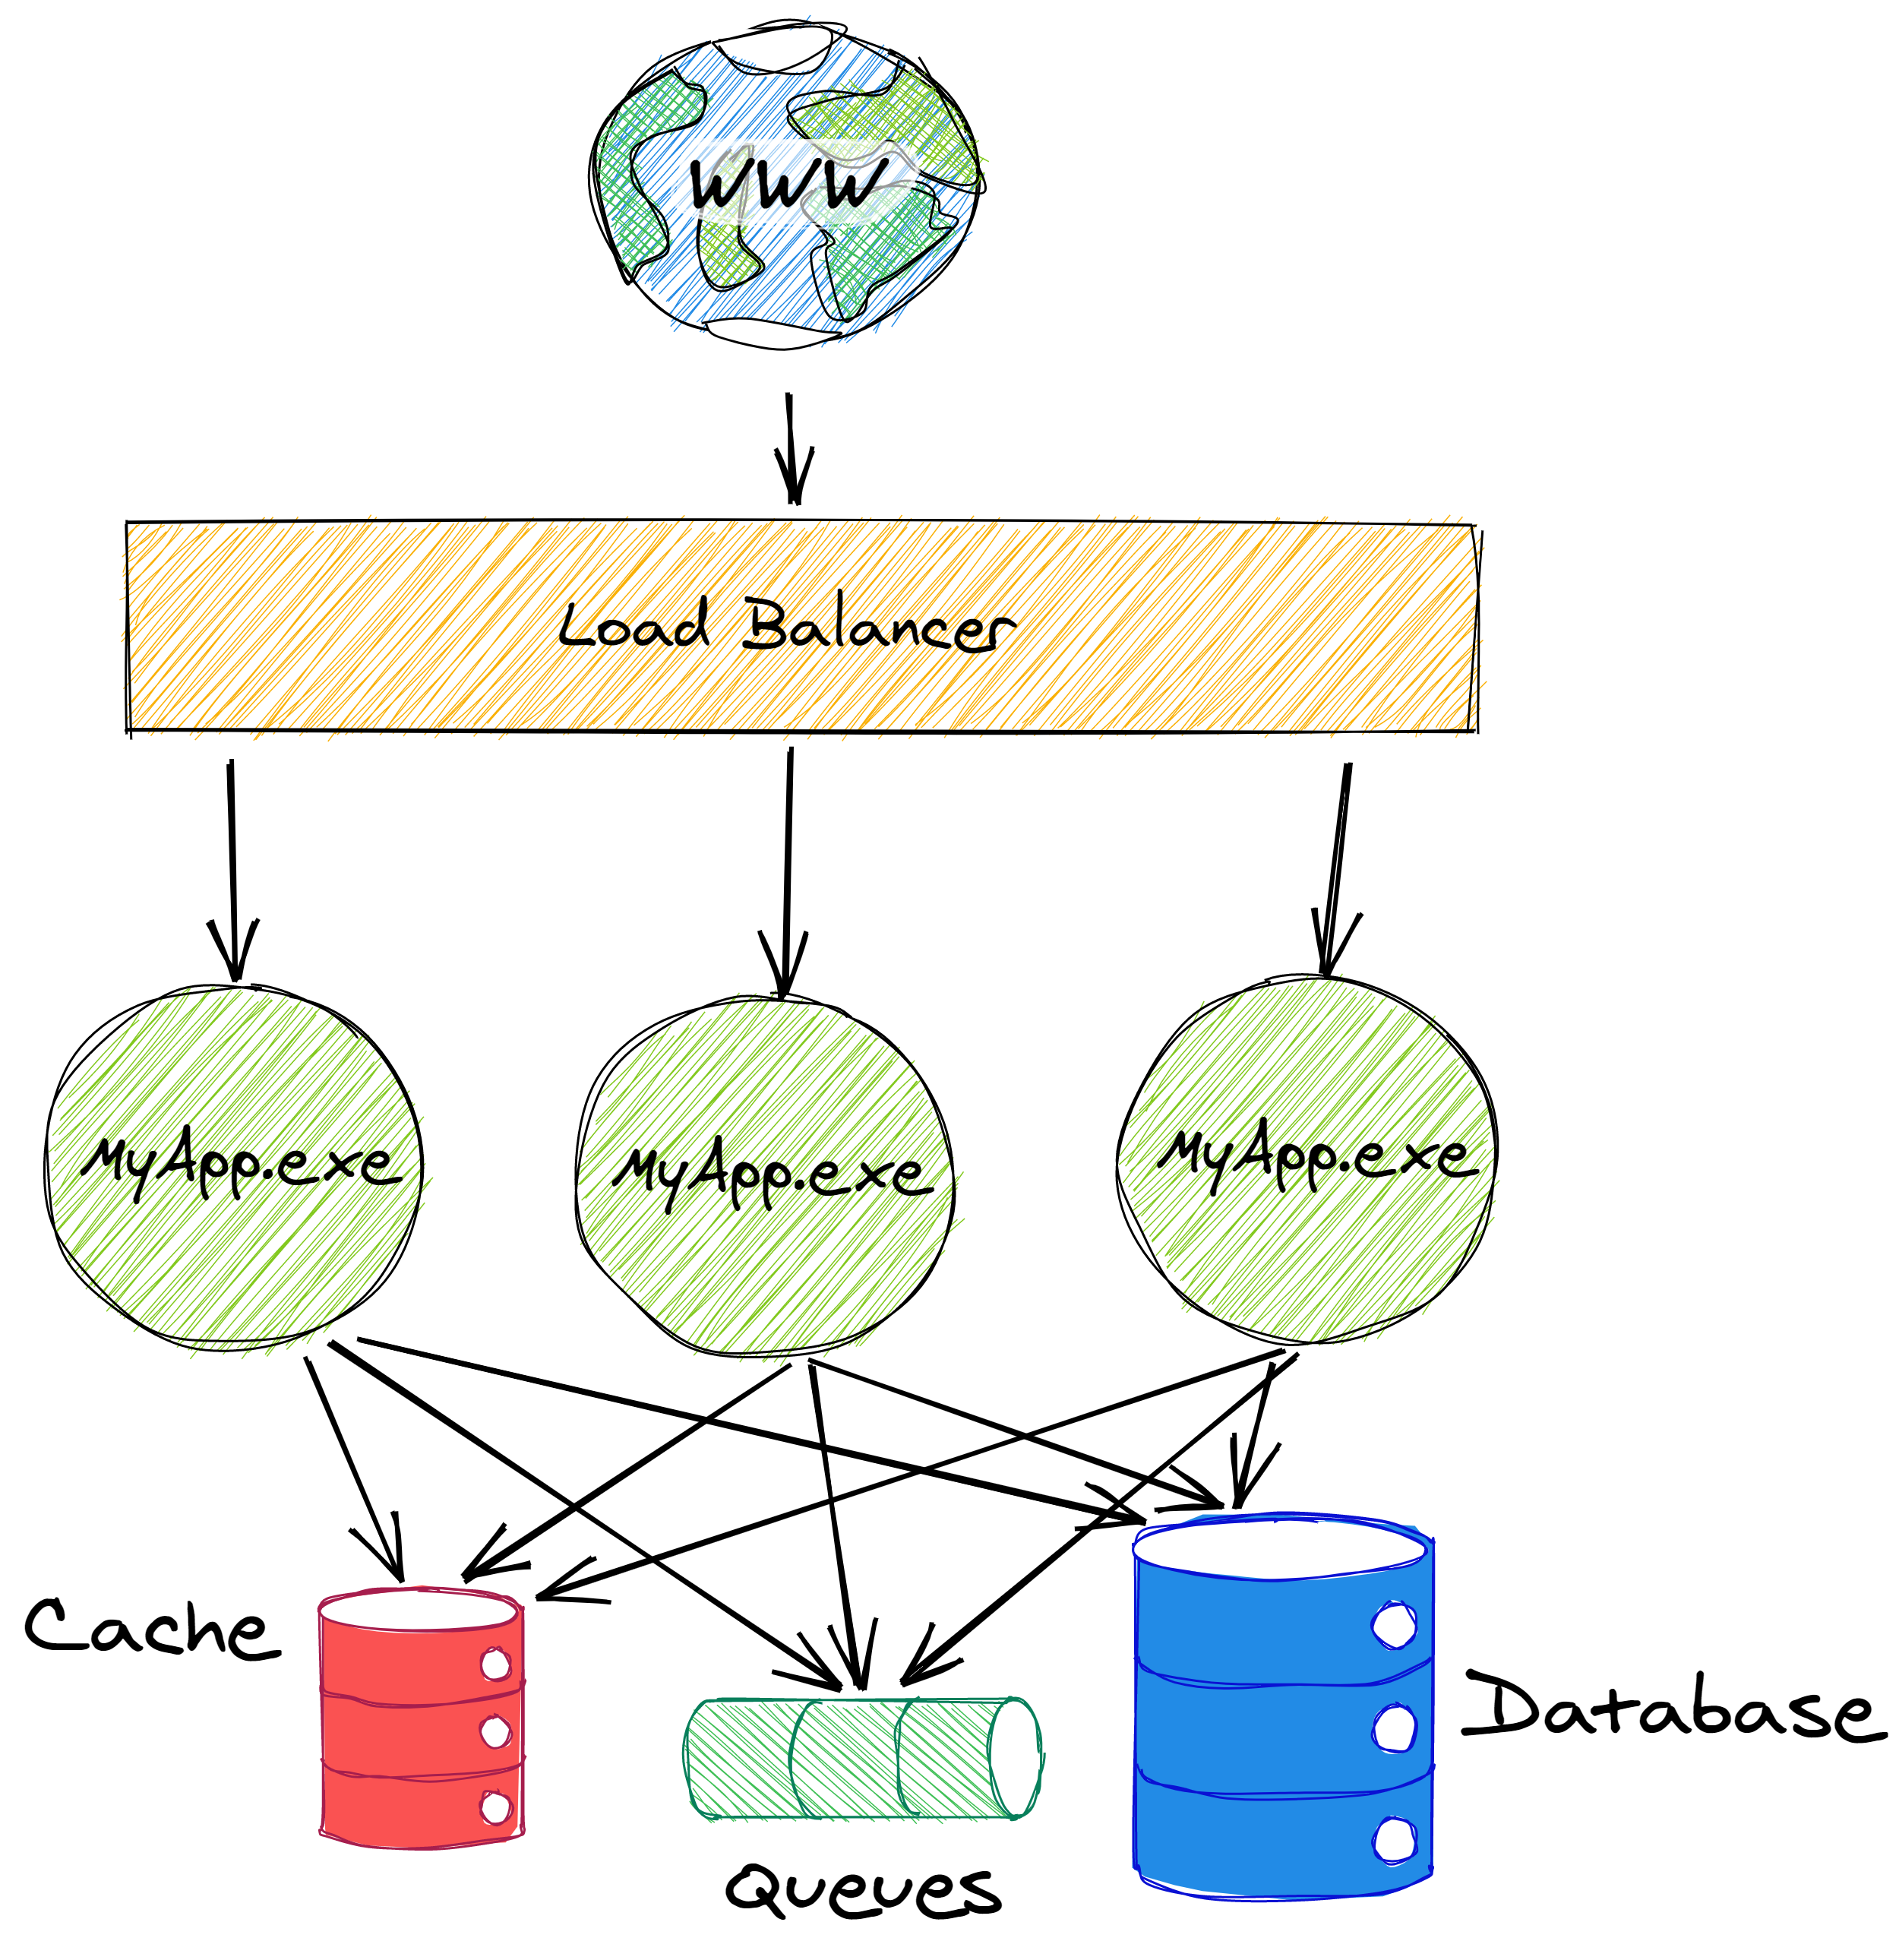
Notes:
Now we have a queue. When we want to update some data, we will put a message in a queue and some worker will be responsible for reading that message and updating both the cache and the database. There are many variants of this approach:
You can use the database or the cache to create a kind of work scheduling system, instead.
The core idea is the same: you put the responsibility of coordinating writes onto something else.

Slide 9
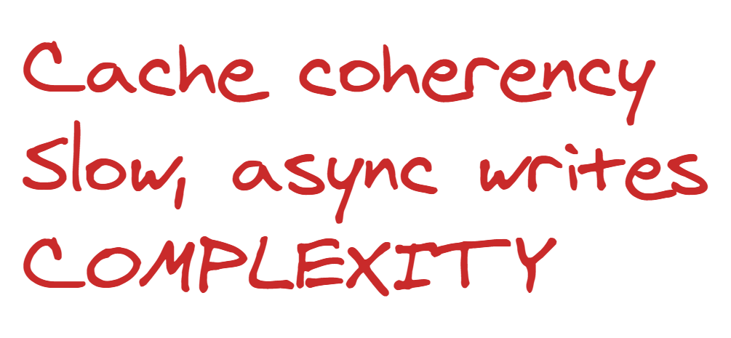
Notes:
Now we have a queue. When we want to update some data, we will put a message in a queue and some worker will be responsible for reading that message and updating both the cache and the database. There are many variants of this approach:
You can use the database or the cache to create a kind of work scheduling system, instead.
The core idea is the same: you put the responsibility of coordinating writes onto something else.
This pushes us to make our writes asynchronous, which often involves some kind of polling or background notification.
That can be useful in some cases, but ideally we don’t want to NEED that complexity.
It’s also even slower than just writing directly to the database.
All in all, we have a whole lot of complexity and we still haven’t solved all of our problems. So what’s the solution?

Slide 10
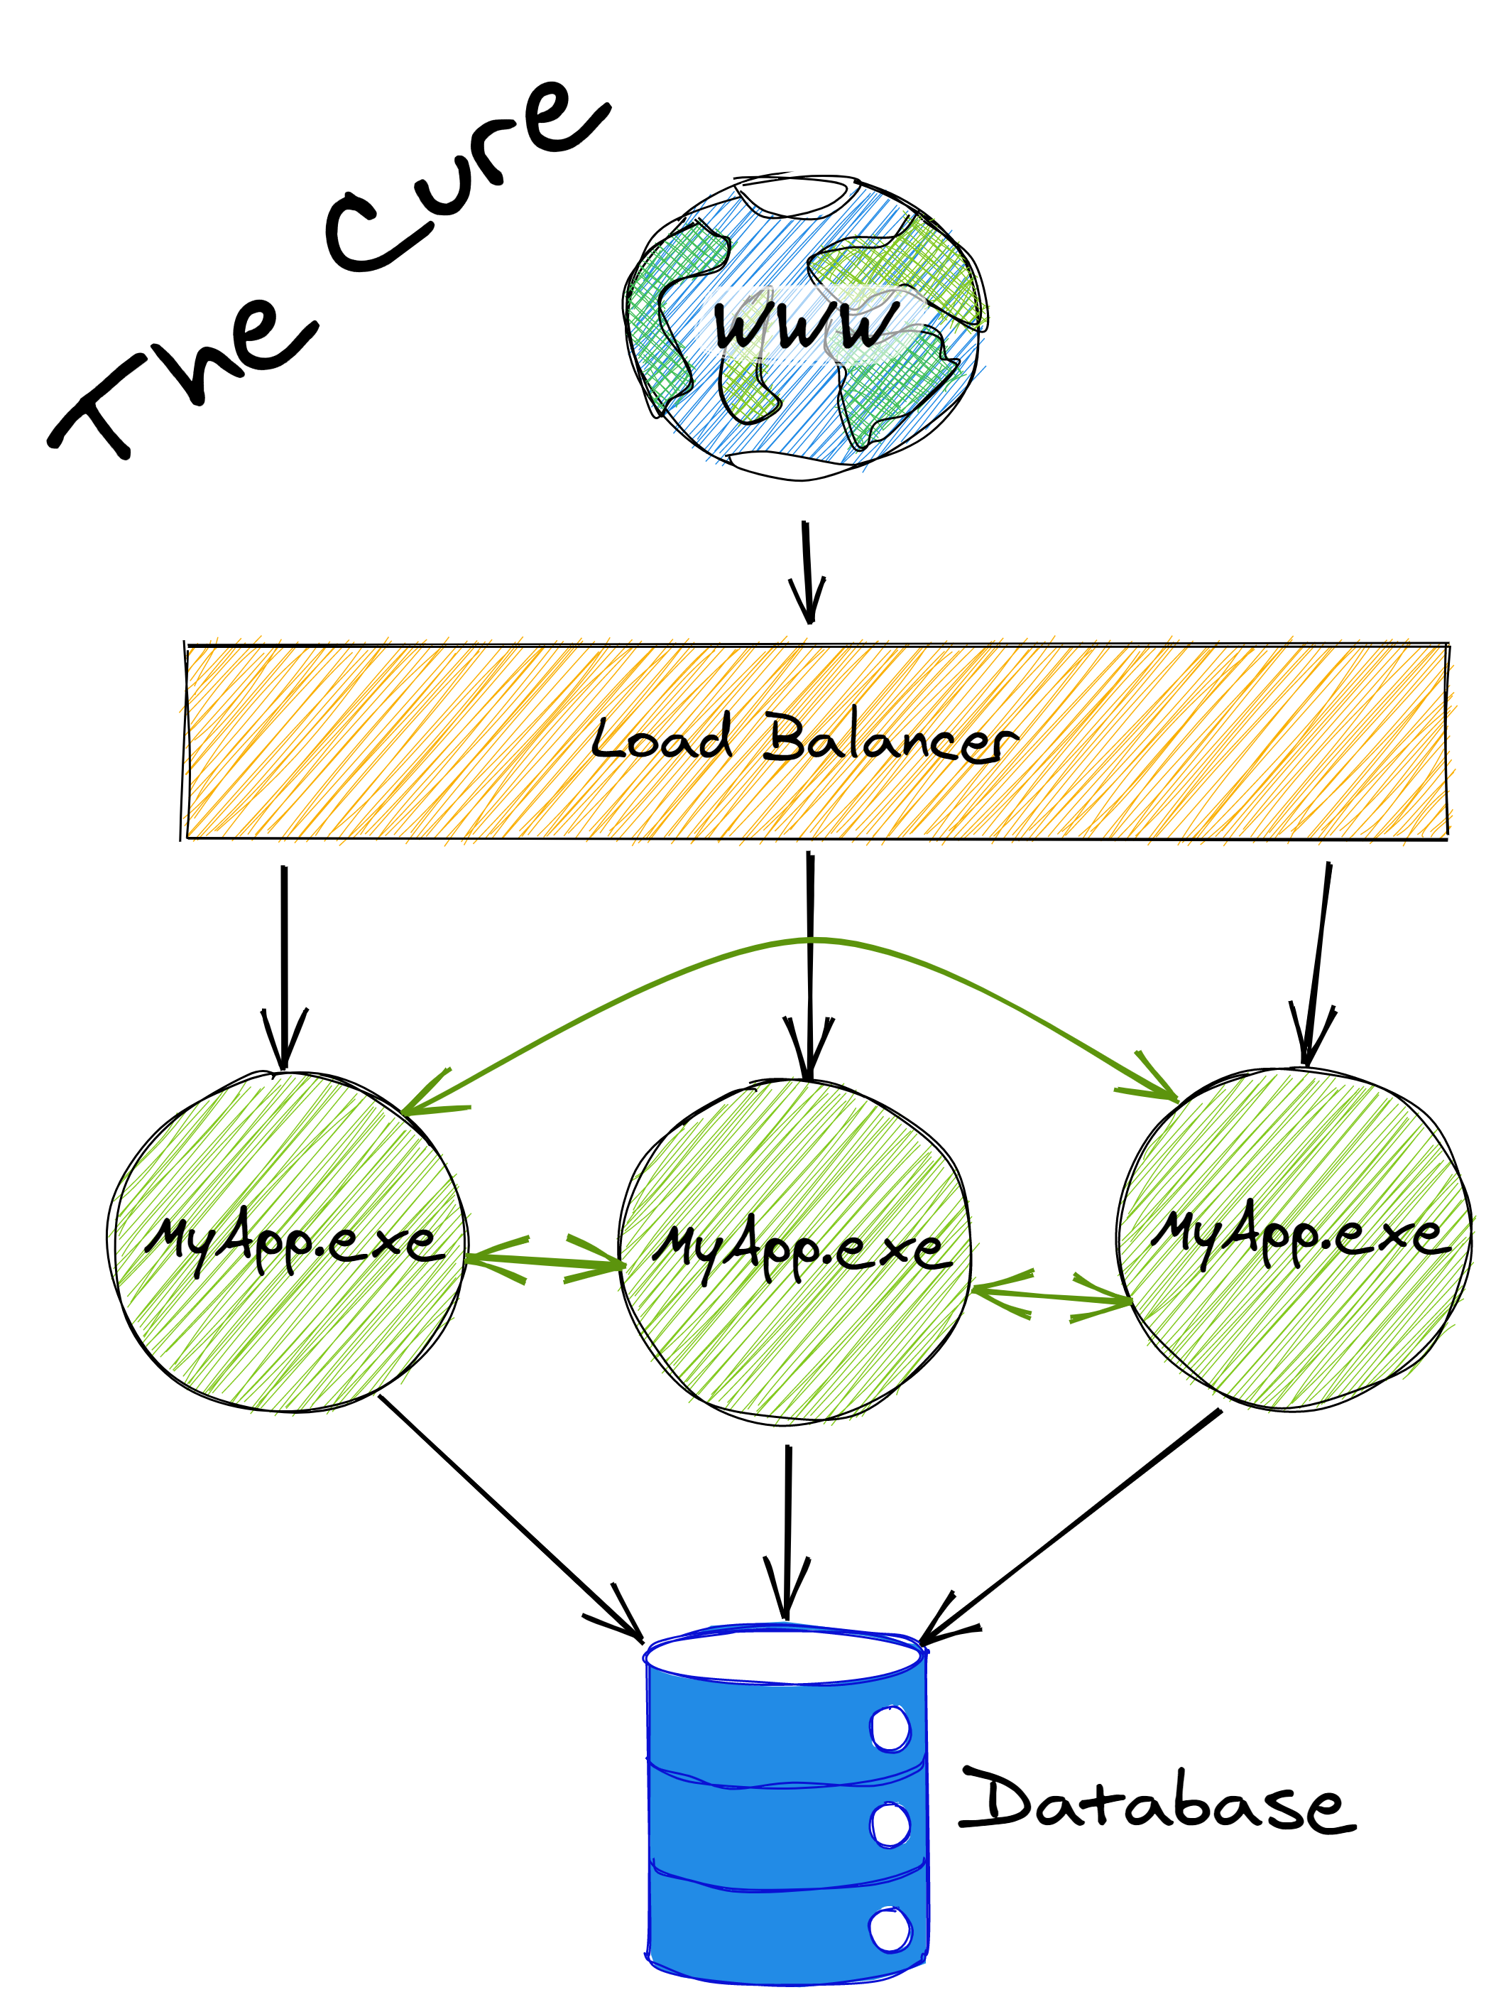
Notes:
What’s the cure. Obviously, this is about Orleans, so Orleans is the cure.
Orleans adds those green arrows in the architecture diagram. It lets your app instances talk to each other.
By doing that, we can we can very efficiently cache data and coordinate writes.
We don’t have cache coherency issues, or write contention, or crazy dependencies or complicated code with retry logic everywhere.
Everything is fast, easy to understand and code for, and reliable. And it scales up or out as far as you need.
This is a deep dive, so I want to talk about how Orleans adds those Green Arrows, and when you write Orleans code, what happens behind the scenes.

Slide 11
Stateless vs. Stateful Services
Stateless service
Load state from storage, execute request, write to storage if needed
Easiest to implement, no coordination across requests
Storage is the bottleneck
Caches help but complicate
Data shipping
Stateful service
Keep loaded state in memory
Route requests to the right server*
Write-through to storage
Serve read requests from memory, only touch storage on writes
*Gets complicated quickly if servers can fail or scale out/in
Function shipping
Frontends
Middle Tier
Cache
Storage

Slide 12
Microsoft Orleans
Framework for stateful, cloud-based applications
Programming model
Runtime
Building-block: grains (cloud-native objects)
Runtime handles scale out/in, fault tolerance, service discovery, load balancing, messaging, routing
From Microsoft Research, now part of .NET
Adopted by many Microsoft product groups, running in production for almost a decade
Eg: Azure Digital Twins, Halo, Microsoft Mesh, Dynamics 365 Fraud Protection, Azure ML, Azure Quantum, Azure PlayFab
Notes:
The entities or objects in Orleans have their own name. We call them grains, like a grain of wheat.
It’s high-performance, completely open source, written in C#, and has been battle-hardened over almost a decade of production use within many of Microsoft’s cloud services as well as many other company’s services.

Slide 13
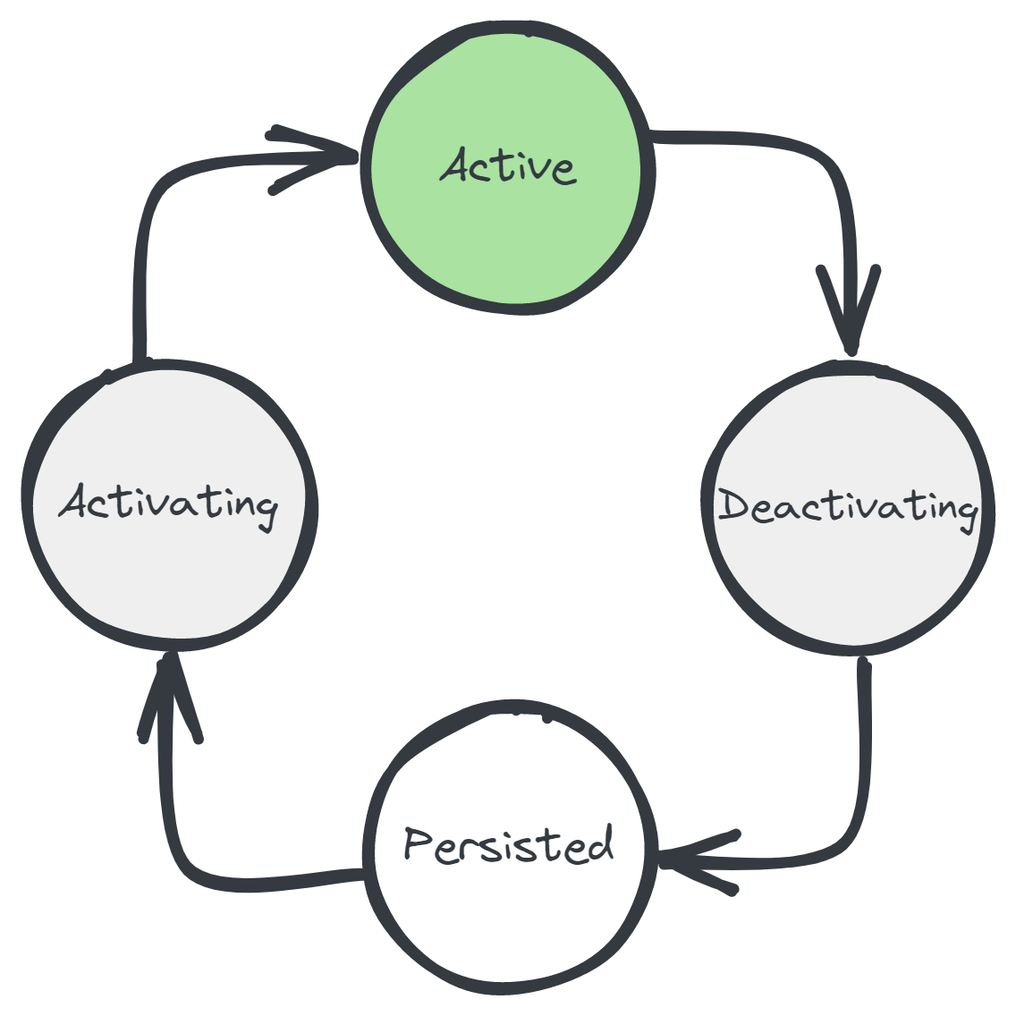
Grains
Consist of a unique ID, a class, & (persistent) state
Live forever, virtually
Managed lifecycle
Location-transparent
Communicate by messaging
Strongly-typed RPC interfaces
Single-threaded by default
try/catch error handling
Notes:
Single-threaded -> Less bugs, no locks, easier to coordinate writes to storage

Slide 14
Grains – Benefits
Less database reads
Hot/warm data is kept in-memory, cold data is in database
No need for a separate cache – great for soft state
Less database write contention
Each grain owns its own state
Less cache coherency issues
Writes update the grain’s state, grain updates the database
Grains act like a smart, write-through cache
Better scalability
Grains are spread out over your application instances
Low-latency writes
No need for async writes via a queue/worker
Simplicity!
Less code, less infrastructure, less error handling, less retry logic

Slide 15
Frontends
Orleans
Storage
Notes:
I want to talk about the fault tolerance aspect of the Orleans runtime for a moment.

Slide 16
Frontends
Orleans
Storage

Slide 17
Frontends
Orleans
Storage
ProbeRequest
ProbeRequest

Slide 18
Frontends
Orleans
Storage
ProbeResponse
ProbeResponse

Slide 19
Frontends
Orleans
Storage
ProbeRequest
ProbeRequest

Slide 20

Frontends
Orleans
Storage
ProbeRequest
ProbeRequest

Slide 21
Frontends
Orleans
Storage
ProbeRequest
ProbeRequest

Slide 22
Frontends
Orleans
Storage

Slide 23
public interface IUserGrain : IGrainWithStringKey
{
Task SendMessage(IUserGrain from, string msg);
Task<List<Message>> GetMessages();
}
Notes:
That was all rather conceptual, so it’s time for the only code slide I have for you today.
Here’s what a grain looks like in code, complete with reading and writing from storage.
So you have an interface up top. That’s how we’ll communicate with it.
Then there’s an implementation down bottom.
In the box at the top right, that’s how you get a reference to a grain and then call it.
Looking at that SendMessage implementation, there are no locks to protect the state from being updated by other callers.
That’s because grains run one call at a time by default, for simplicity. You can customize that.
We also never load state. It’s loaded automatically before the grain starts handling calls.
Because grains are stateful, you don’t have to load state before every call, you load it once and keep it around, only writing changes back to storage.
That’s good for perf and lightening the load on the database.
This is just a very quick overview, so for more info, there are docs and samples and other talks that I can link you to.

Slide 24
public class UserGrain : Grain, IUserGrain
{
IPersistentState<List<Message>> _msgs;
public UserGrain([PersistentState("msgs")] IPersistentState<List<Message>> state)
=> _msgs = state;
public Task<List<Message>> GetMessages() => Task.FromResult(_msgs.Value);
public async Task SendMessage(IUserGrain sender, string body)
{
_msgs.Value.Add(new Message { Sender = sender, Body = body });
await _msgs.WriteStateAsync();
}
}
We never loaded the state…
Methods are always single-threaded
Notes:
Impl interface
Persistent state – declarative.
Inject into constructor
Orleans uses a plugin model, so the state can go into any database you like.
The community has published providers for many different data stores.
GetMessage => returns immediately out of memory, very fast, low latency
SendMessage => Still benefit from in-memory, but this time we do have to write to storage to keep it durable.
No locks in Send Message since single-threaded!
This code should be familiar to a lot of programmers, but it scales very well

Slide 25
// Get grain references. Synchronous & cheap
IUserGrain me = client.GetGrain<IUserGrain>("reuben");
IUserGrain friend = client.GetGrain<IUserGrain>("JotB");
// Call them
await friend.SendMessage(me, "hey :)");
var messages = await me.GetMessages();
Notes:
Get REFERENCE to a grain by name
Note: synchronous call, it’s essentially like a typed URL, very cheap.
Next: send a call. NOTE: pass “me” by reference to friend grain. Compose grains together by passing references around.
Get our messages.
Note: we never activated anything. This is a key part to the programming model.
The runtime abstracts this away from us.

Slide 26
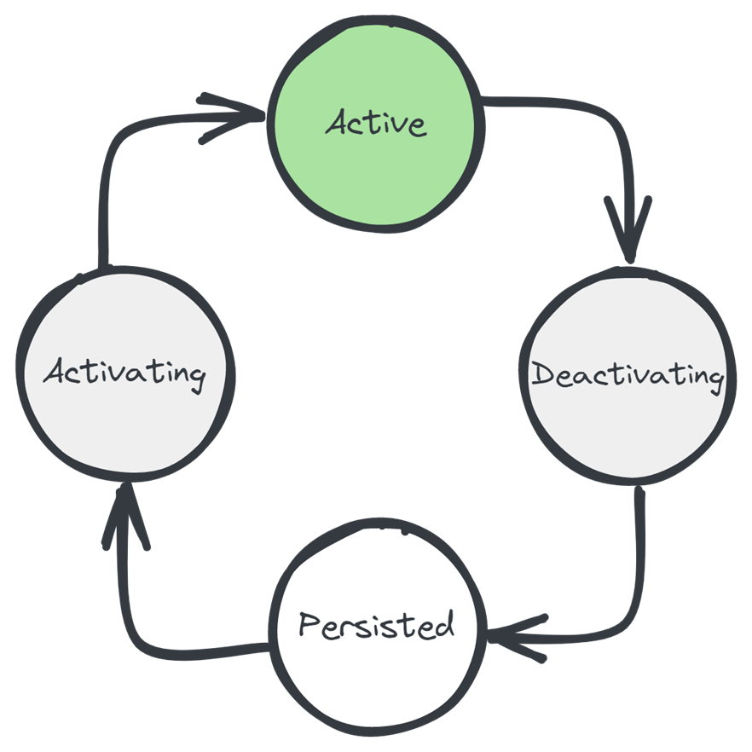
Managed lifecycle
Notes:
THIS is *key*​
​
There when you need them​
​
We’ll talk more about it in a few slides….​

Slide 27
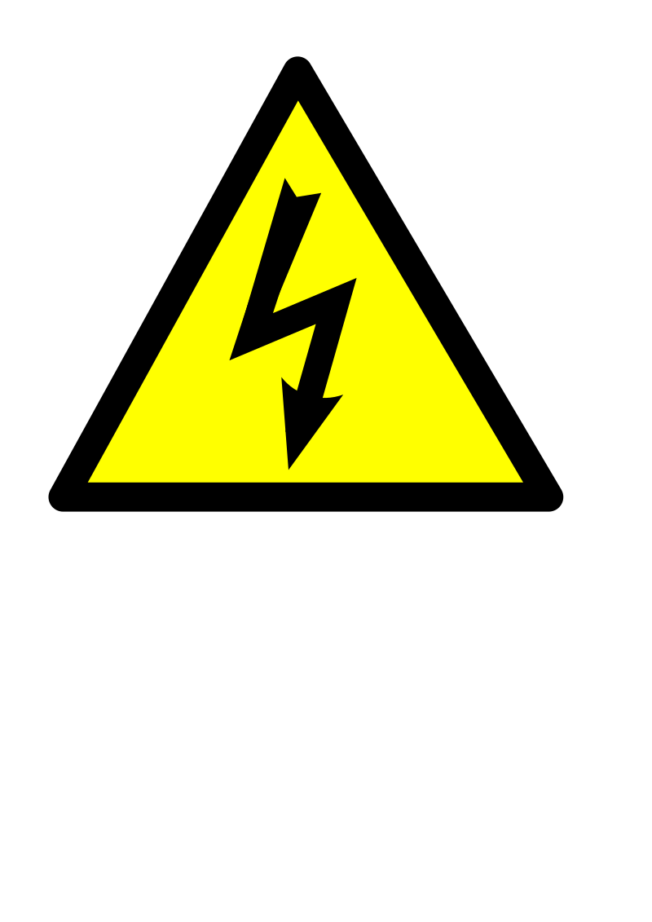
"hi :)"
A
try
{
await friend.SendMessage(me, "hi :)");
}
catch (Exception exception)
{
Console.WriteLine(
$"Message failed, was I blocked?! {exception}");
}
!!!
"hi :)"
!!!
Distributed
asynchronous
try/catch
semantics!
B
"hi :)"
!!!
C

Slide 28
Summary: Grains
Grain = identity + behavior [+ state]
~“Distributed Object”
Communicate via interfaces
Managed lifecycle
try/catch for error handling
Location transparency
Single-threaded (Actors!)

Slide 29
Grains
Treat our cluster like one big machine
Divide our app up into many little objects (Grains)
One for each user profile, shopping cart, game session, chat room, blog post, big compute job, or object in Mixed Reality
Each one gets an id, a class, and some persistent state
Or many pieces of state, or no state (stateless!)
Spread them around our cluster
Load them into memory as needed
Unload them when they’ve become idle
Route messages to them
Every IBlogPost.Get() call for “blog-post/dotnet-perf-tuning” goes to the same object
Make each one single-threaded
Less bugs, no locks, easier to coordinate writes to storage

Slide 30
Orleans Features
Persistence
Plugins for Azure Storage, Cosmos DB, SQL, DynamoDB, Redis, MongoDB, …
Distributed ACID transactions
Read/write state in multiple grains transactionally
Virtual streams
Decouple producers & consumers. Backed by Azure Event Hubs, Amazon SQS, GCP, in-memory
Timers & reminders
Ephemeral timers, persistent reminders for scheduling future event
Observers
Grains can send events (RPC calls) directly to clients. Eg, push notifications, streams
Transport layer security
Mutual TLS between clients and the cluster as well as nodes within the cluster
Deployment freedom
Azure, AWS, GCP, on-prem, Kubernetes, Service Fabric, Windows, Linux, macOS
Custom placement & directory
Customize how the runtime decides where new grains are instantiated & how it finds them. “Move computation to data”
Call filters
Wrap incoming & outgoing requests & responses for logging, tracing, error handling
.NET integration
DI/Logging/Hosting/Configuration
Notes:
~3 mins
Alright, last slide about the framework, and I just wanted to highlight a few of the features here
# Persistence
Nice and simple, .NET objects and method calls. Can change backends easily.
Fine to avoid.
# Transactions
Very cool! Unique!
Transactional State
Transfer Method
Transactions can really simplify your life because there are a lot of error cases that you don’t need to consider when using transactions.
7:30
# Virtual Streams
RPC is a great
Decouple both sides of the communication, decouple temporally -> Orleans Streams! Pluggable
Declarative bindings
# Deployment freedom
Orleans is unopinionated about where it runs. You can add Orleans to the .NET Generic Host Builder, so it works just about everywhere. Internally, teams are running Orleans on Linux, Windows, AKS, Service Fabric, Azure Cloud Services, or bare VMs.
END OF ORLEANS RECAP

Slide 31
Lab 1: Hello, Orleans
Setting up your environment and creating an absolutely minimal Orleans application

Slide 32
Repository URL
https://github.com/ReubenBond/jotb22-orleans-workshop
PLANTA_CERO
Polodigital20

Slide 33
Lab 2: Hello, Grains
Creating & calling your first grain

Slide 34
Grain Persistence
How do grains store persistent state?
We’ve seen an example or two of using IPersistentState<T> already
One size does not fit all:
What if you need secondary indexes?
What if you need more control over storage format (eg, columns in an SQL database)?
What if your state
Answer: use a different abstraction. The out-of-the-box abstraction is simple and works with most databases, but won’t fit all needs

Slide 35
Lab 3: Dealing with State
Using the grain persistence APIs

Slide 36
Timers & Reminders

Slide 37
Timers vs Reminders
Timers
Reminders
Unique to a grain
Can fire multiple times per minute
Ephemeral, in-memory only
Reentrant – can execute while another grain is awaiting some call
Unique to a grain
Restricted to periods greater than 1 minute
Persistent, stored in a database
Non-reentrant – invoked one-by-one like a normal grain call

Slide 38
Timers API
/// <summary>
/// Registers a timer to send periodic callbacks to this grain.
/// </summary>
/// <param name="asyncCallback">
/// Callback function to be invoked when timer ticks.
/// </param>
/// <param name="state">
/// State object that will be passed as argument when calling the asyncCallback.
/// </param>
/// <param name="dueTime">Due time for first timer tick.</param>
/// <param name="period">Period of subsequent timer ticks.</param>
/// <returns>Handle for this Timer.</returns>
protected IDisposable RegisterTimer(
Func<object, Task> asyncCallback,
object state,
TimeSpan dueTime,
TimeSpan period)

Slide 39
Reminders API
Grain must implement IRemindable!
Task<IGrainReminder> RegisterOrUpdateReminder(
string reminderName,
TimeSpan dueTime,
TimeSpan period)
Task UnregisterReminder(IGrainReminder reminder)
Task<IGrainReminder> GetReminder(string reminderName)
Task<List<IGrainReminder>> GetReminders()

Slide 40
Lab: Timers & Reminders

Slide 41
Request Context
Request Context allows you to flow information along a chain of grain calls
API is simple, essentially Dictionary<string, object>
Access via RequestContext static class, eg:
RequestContext.Set("user_id", val);
RequestContext.Get("user_id")

Slide 42
Grain Call Filters
Execute hooks around incoming and outgoing grain calls
IIncomingGrainCallFilter vs IOutgoingGrainCallFilter
Useful for: retries/error handling, logging, distributed tracing, flowing authorization context, access control
Both types of filters allow access to the target grain type, interface, method
Register call filters using Dependency Injection, eg:
siloBuilder.AddIncomingGrainCallFilter<TMyFilter>()

Slide 43
public interface IIncomingGrainCallFilter
{
/// <summary>
/// Invokes this filter.
/// </summary>
/// <param name="context">The grain call context.</param>
/// <returns>
/// A <see cref="Task"/> representing the work performed.
/// </returns>
Task Invoke(IIncomingGrainCallContext context);
}

Slide 44
public interface IGrainCallContext
{
IAddressable Grain { get; }
MethodInfo InterfaceMethod { get; }
object[] Arguments { get; }
Task Invoke();
object Result { get; set; }
}
public interface IIncomingGrainCallContext : IGrainCallContext
{
MethodInfo ImplementationMethod { get; }
}

Slide 45
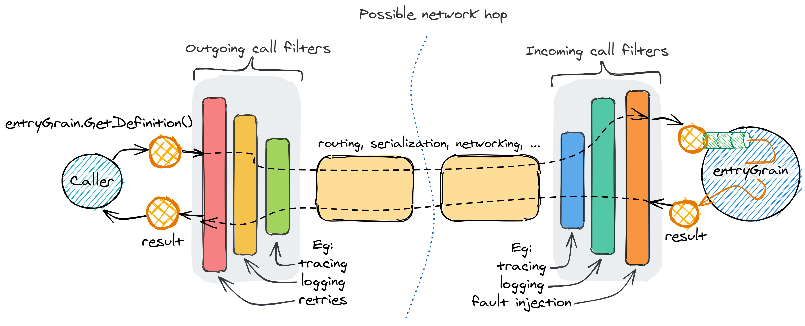
Grain Call Filters

Slide 46
Grain lifecycle methods
Constructor – inject services
OnActivateAsync() – load data, perform async operations
Note: grains cannot accept incoming calls until they finish activation!
OnDeactivateAsync()
IDisposable.Dispose() or IAsyncDisposable.DisposeAsync()

Slide 47
Clustering
Scaling out your application

Slide 48
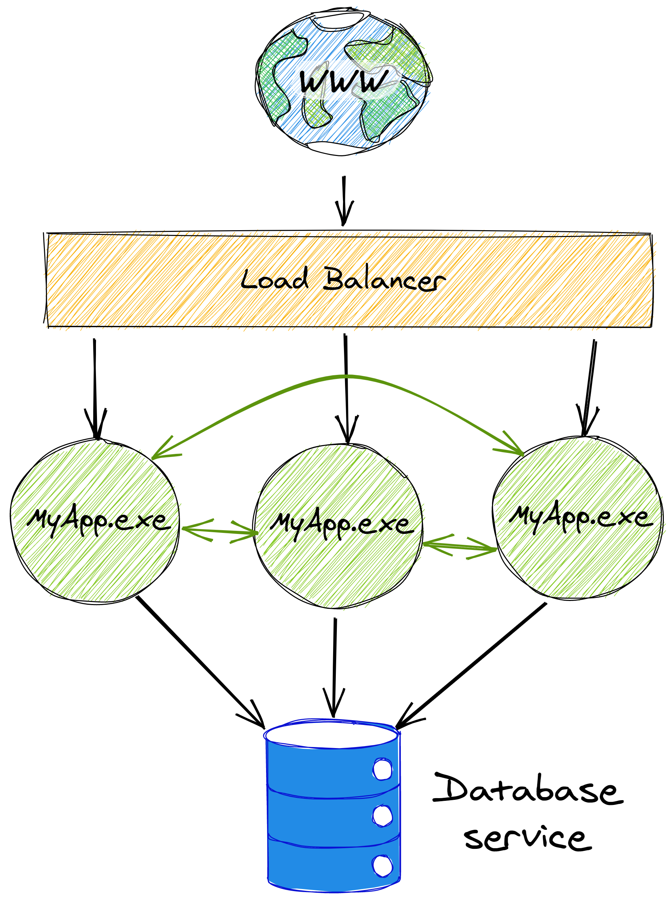
A simple Orleans application
Eg .NET app with Orleans and ASP.NET Core MVC
All data persisted in a managed database service
For Orleans to work, app instances need to communicate with each other

Slide 49
Questions
How do instances of your app find each other?
What happens when we scale the application out?
If an instance fails or shuts down, what happens?

Slide 50
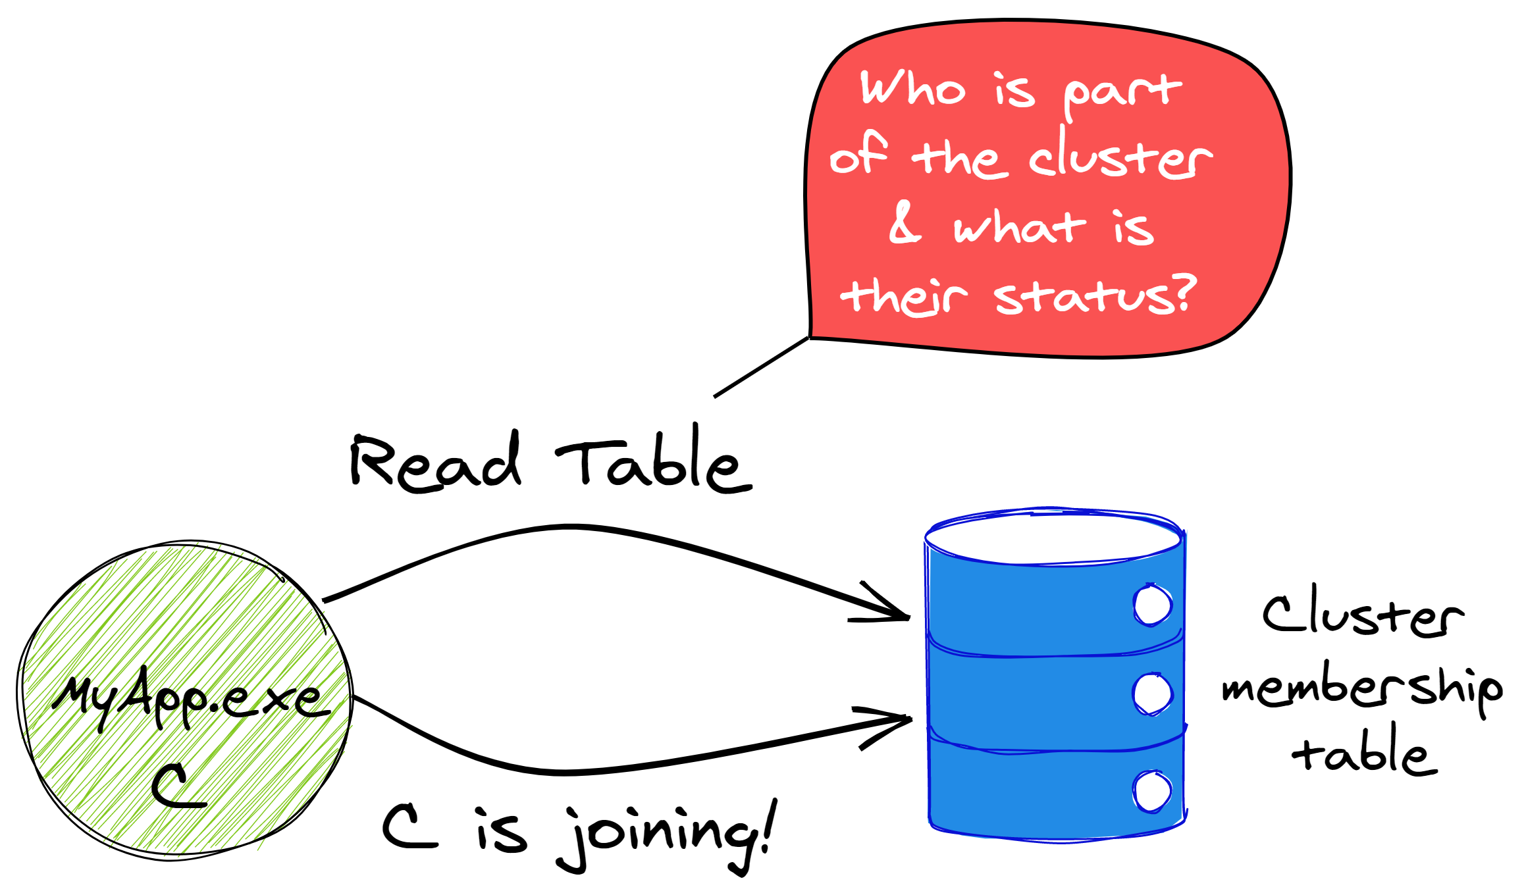
Discovery
A database is the source of truth
Notes:
Ok, how do instances of your Orleans app find each other? The short answer is that they use a database as a central meeting point.
The database can be anything, it can be Azure Table Storage, or another traditional database, or Redis, or Consul/ZooKeeper, or even Kubernetes CRDs.
There are a lot of plugins and it’s easy to add more.

Slide 51
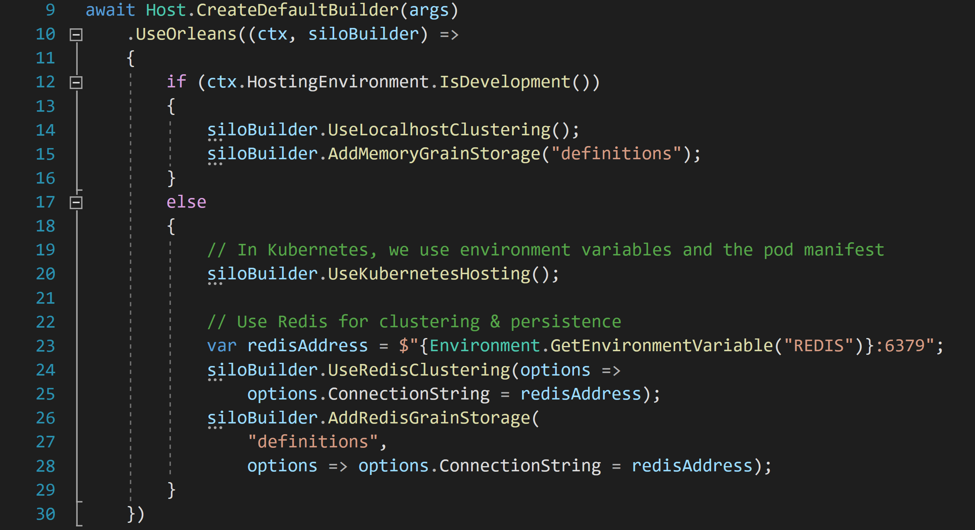

Slide 52
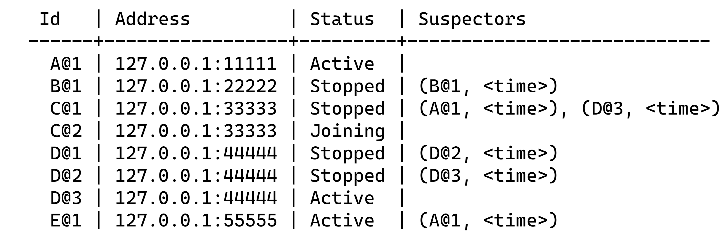
Cluster Membership Table

Slide 53
How do we maintain cluster health?
Each server monitors several other servers
Each server is monitored by several others
Servers send each other health probes (ping messages), expecting to receive responses (pong messages)
If a server fails to respond, it will eventually be declared ‘down’ and removed from the cluster

Slide 54
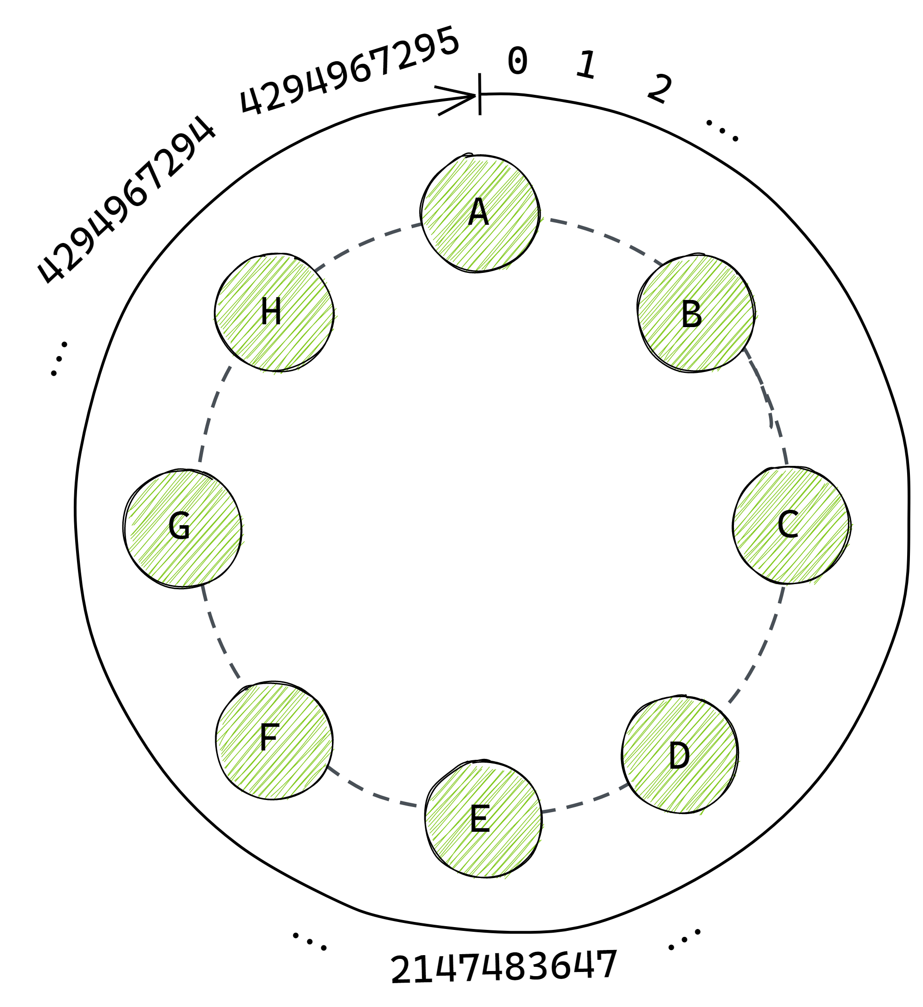
Who monitors who?
Each server has a unique id
Take the hash of the id and arrange it into a ring ordered by id
This is a Consistent Hash Ring.
We use it to determine which server monitors which other servers

Slide 55
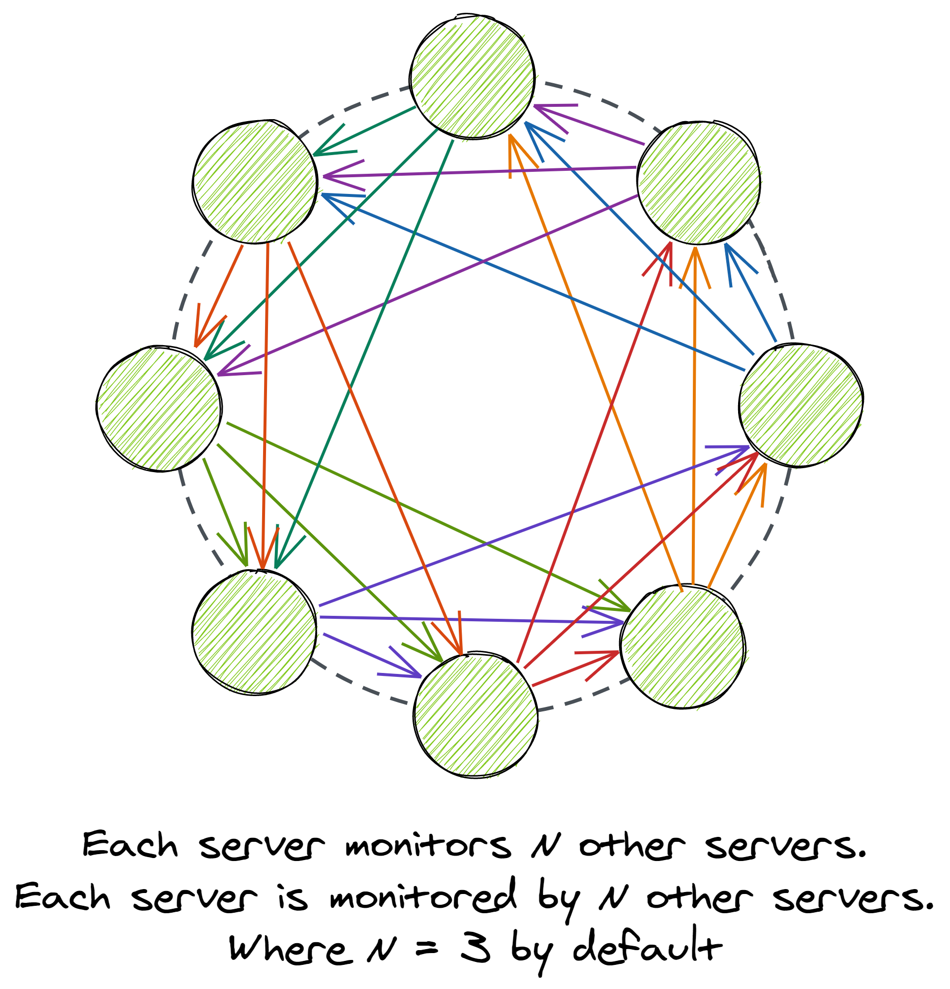
Who monitors who?
Each server has a unique id
Take the hash of the id and arrange it into a ring ordered by id
This is a Consistent Hash Ring.
We use it to determine which server monitors which other servers

Slide 56
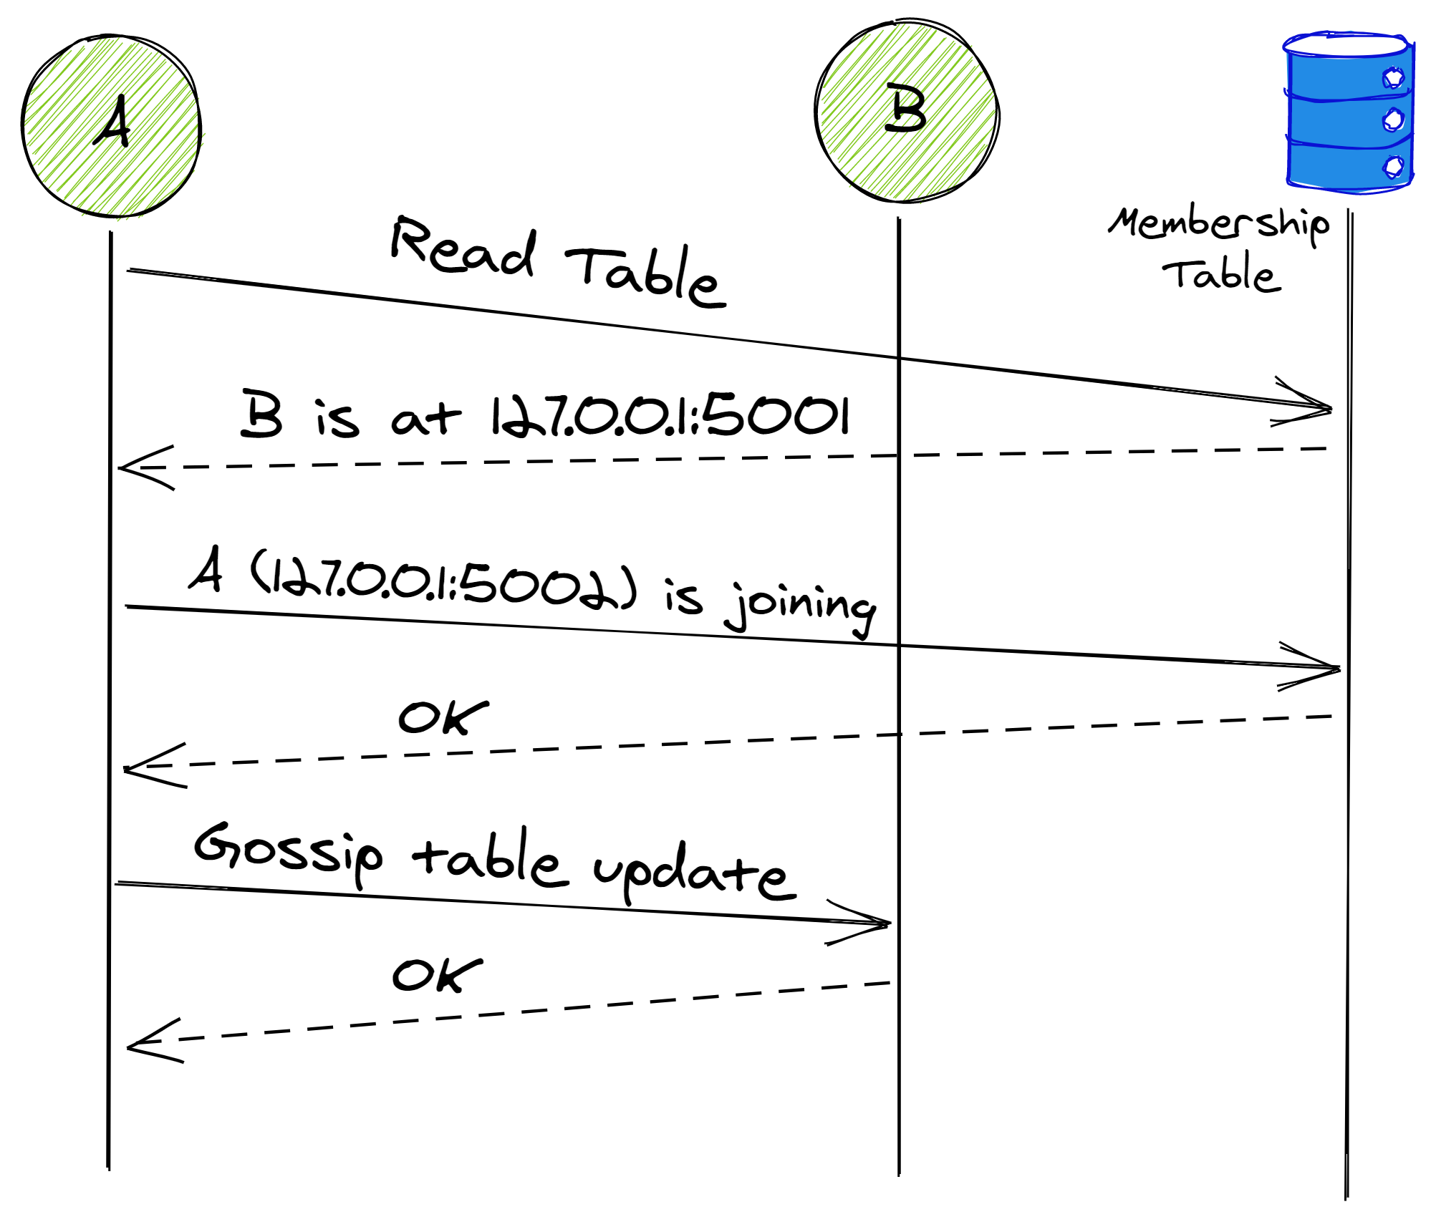
Notes:
Ok, so we understand the basic idea there’s a database table that’s used for finding all of the instances of the app.
Here’s how it looks when a new instance starts up.
Here, A is joining and B is already up.
So A reads the table then updates it to say it’s joining, and connects to B.
When it connects to B it also sends the updated table.
That helps to prevent write conflicts against the table.
Now this is what happens whenever a new app instance starts up.
When you scale your app out, this happens, too, as the new instances start.

Slide 57
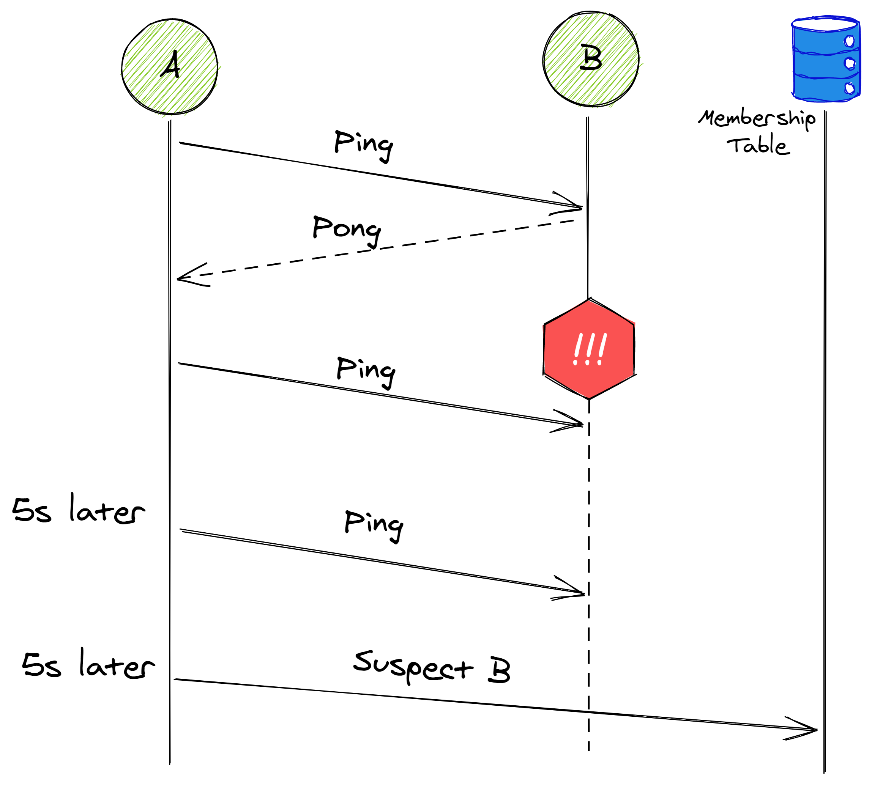
Notes:
So that’s all good. What happens when one of the app instances suddenly disappears.
Lets say that someone trips over the network cable, for example.
Well, Orleans needs some way of knowing that. And this is where things get a little more complex.
Every process will monitor a bunch of other processes, and Orleans makes sure that the load is evenly divided so that there are always a few processes monitoring any given other process.
Anyway, so they send periodic ping messages between each other. Usually, they will receive a PONG in response, very quickly.
If they don’t, they will try again after some time, eg 5 secs.
If that fails, then they will update the membership table to say that they think the target might be dead.
This is a voting process.

Slide 58
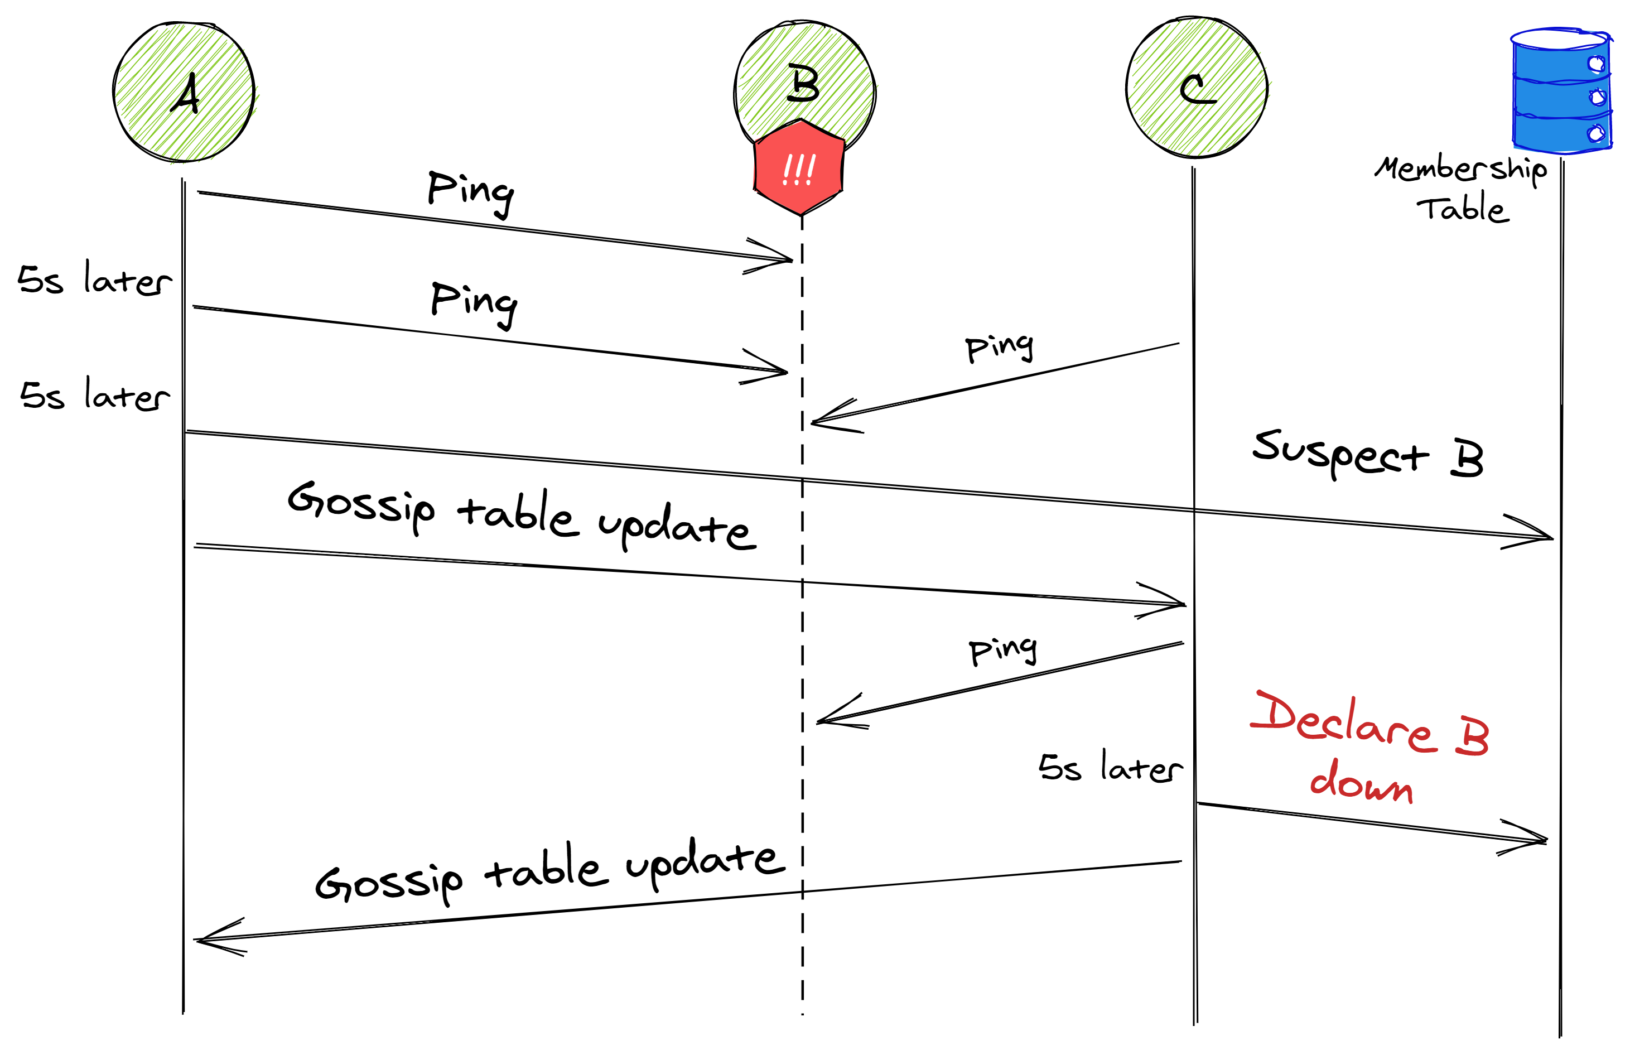
Notes:
So, taking that further, is A & C both think that B is down, then the last one to vote will declare it dead.
In this case, that’s C.
At that point, Orleans will rebalance things around the cluster and automatically heal itself.
This is the basics of how cluster membership works.
We could go into a lot more detail, but that can fill multiple hours. If you want to know more about the intricate details, then we can chat on Twitter or Gitter and I can share some details and some research and lecture videos with you.
Think about what happens if A & C are actually just very very slow, so they might THINK B is down, but it’s actually fine, and A & C are the real problem.
Another think to consider is that if B is just very slow then it might not respond to messages in time. So it needs to learn that it was voted out while it was asleep and recover.

Slide 59
Diving Deeper
What’s the difference between a crashed process and a very slow process or one which has a temporary network issue?
Maybe the reason we don’t see timely responses to probes is because:
We are disconnected from the network
Our process is running very slowly
Can an unhealthy host vote a healthy one out?
These are real issues to solve
Some are impossible to fully solve

Slide 60
Diving Deeper
What’s the difference between a crashed process and a very slow process or one which has a temporary network issue?
Effectively none. Slow/disconnected processes may come back, crashed ones can restart but will have different id
Maybe the reason we don’t see timely responses to our probes is because:
We are disconnected from the network
Our process is running very slowly
Solution:
Run self-health checks before voting
Perform indirect probes – ask a friend to check as well
Require multiple votes to decide a host is down

Slide 61
Lab: Clustering

Slide 62
Placement

Slide 63
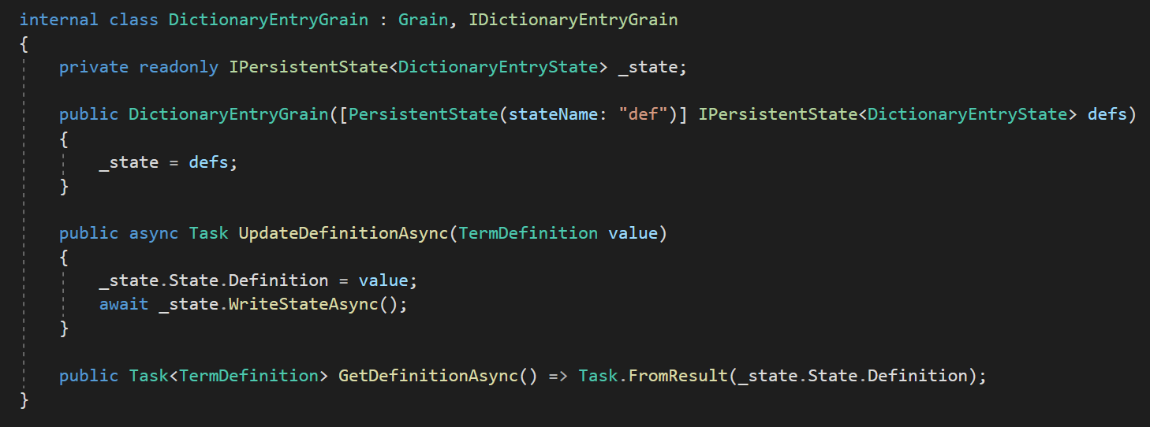
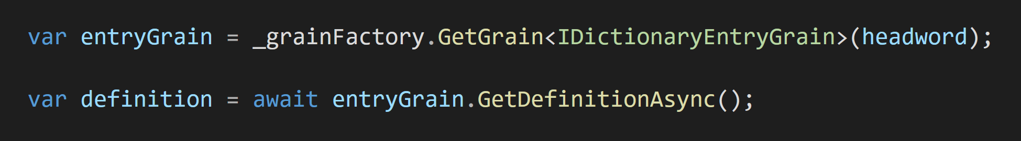
Inject some named state
Database connections are defined at startup time
Update data & write to DB
Fast reads – no database call
Our grain is identified by a dictionary word
Notes:
Another example, this time I want to show a slightly more involved grain.
This one has some state injected through the constructor – it’s like a binding that you might have seen in Azure Functions

Slide 64
What happens behind the scenes
Orleans uses async RPC (Remote Procedure Call)
Like gRPC, but target object instances instead of services, it supports generics, polymorphism, overloads, multiple parameters per method & other .NET niceties
Generates code for each of your interfaces:
One class to turn your method calls into messages
Called a GrainReference. It implements your interface
One class for each interface method, representing a method call and its arguments
Called an “invokable”. It implements IInvokable
When you call GetGrain<T>(id), Orleans gives you an instance of the first class, called a GrainReference
The reference knows the grain type & id, but nothing about where the grain is active right now

Slide 65
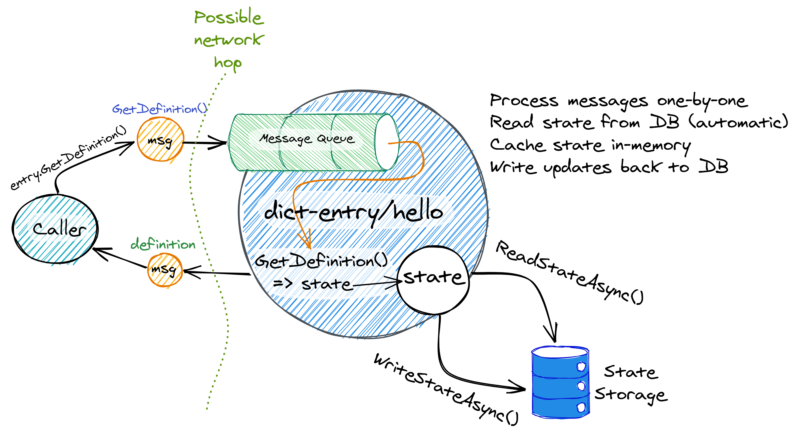
Notes:
So let’s put what we’ve seen so far together. Here’s a diagram of the rough flow for a grain call. We have a caller on the left and then the grain instance is the big blue circle in the middle.
We start at the left, where we have a caller calling the GetDefinition method on our grain.
We know it’s actually a generated GrainReference object that’s being called.
Ok, so that turns the call into a message which is sent, possibly over the network, to our grain.
When the message arrives, it’s enqueued on the grain’s incoming message queue and the grain processes it.
Now we know it’s processed by passing it through that generated GrainMethodInvoker class that we just saw, which turns the message into a method call on the grain.
In this case, the GetDefinition method just synchronously returns some internal state.
Orleans automatically loads that state when the grain is loaded into memory, so the grain code can just return the state immediately.
I drew in the ReadStateAsync & WriteStateAsync calls just to demonstrate that you can explicitly tell the grain to re-read its state, and every time the state is updated, you have to call WriteStateAsync.

Slide 66
What if the grain isn’t active anywhere?
To find where a grain is Orleans uses a Grain Directory
In-built, or pluggable: Redis, Cosmos DB, etc
Lookups are cached & Orleans handles cache invalidation
If a grain is not active when we call it, Orleans needs to place it somewhere. Placement is customizable:
Place randomly
Place next to the caller
Place on the least-loaded app instance
Place closest to the data the grain will need
Place where your heart desires

Slide 67
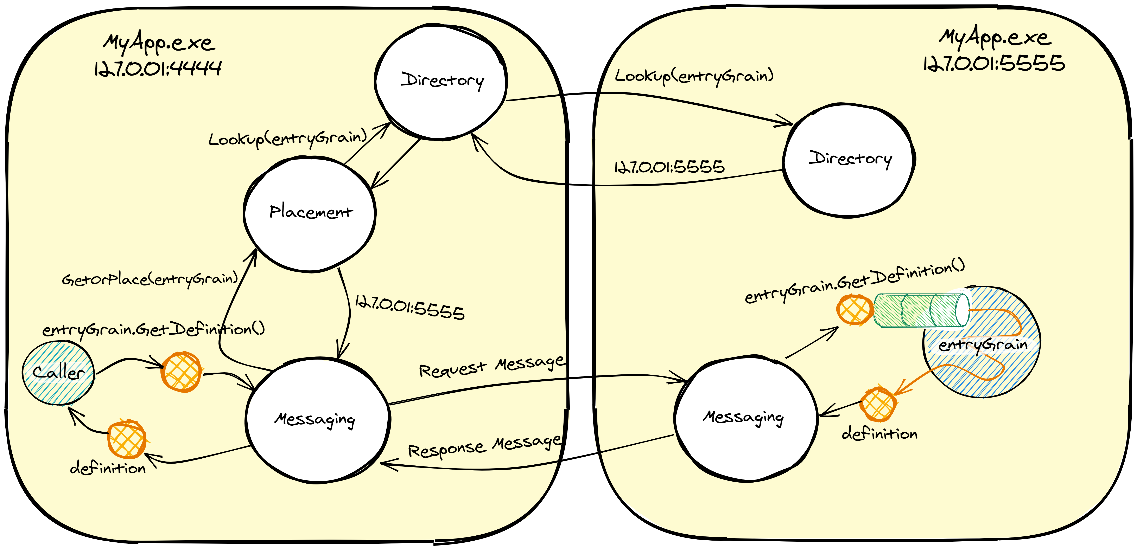
Notes:
So here’s how it looks, all together.
A caller on the left wants to call some grain, and this shows the flow of how Orleans goes and finds where that grain lives
The message is created by the GrainReference, passed to the messaging system, which then needs to address the message
So it calls placement, which potentially calls the directory, which might end up calling a directory on a remote machine.
Then it sends the message to that destination where it’s handled, turning the method into a method call using the GrainMethodInvoker,
And the response is sent back to the original caller.

Slide 68
Placement – Summary
How does the Orleans runtime find grain activations?
Answer: using a grain directory
Similar in concept to DNS, it takes a name and returns an address
How does the Orleans runtime decide where to place new grain activations?
Answer: using a placement director
Given a set of silos (servers), customizable logic determines where each new grain activation should be placed
Aware of heterogeneous deployments, which have a mix of different grain types & interface versions available

Slide 69
Orleans Streams

Slide 70
Streaming
To simplify integration with persistent queues
Consuming and producing events from/to EventHub, Kafka, Azure Queues, etc.
To help consume events
At high rates
Scalable with the cluster size
Reliably in face of failures
Efficiently (batching, locality)

Slide 71

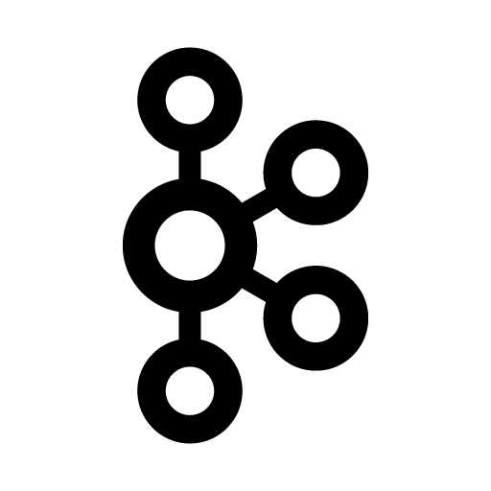
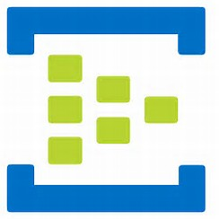
Virtual Streams
Logical (Virtual) Streams 1000s to Ms to Bs
Physical Persistent Queues 10s to 1000s
C
A
A
A
A
A
A
A
A
A
A
A
A
A
A
A
A
B
B
B
B
B
B
B
B
B
B
B
B
B
B
B
B
B
D
C
C
C
C
C
C
C
C
C
C
C
C
C
C
C
C
A
B
B
C
B
C
A
A
A
B
B
C
A
B
B
B
C
A
A
C
A
B
B
A
A
D
D
E
F
E
E
D
F
D
E
F
F
D
D
E
E
F
F
E
F
D
E
D
D
X
Y
Y
Z
Y
Z
X
X
X
Y
Y
Z
X
Y
Y
Y
Z
X
X
Z
X
Y
Y
X
D

Slide 72
Pulling Agents
Y
X
X
Z
X
Z
Y
Z
Z
X
X
Z
X
Z
Y
X
C
A
C
B
B
B
A
C
A
A
B
C
C
C
B
A
D
E
F
F
D
D
D
E
E
D
E
F
F
F
E
D
Grain Directory
Grain Directory
Cluster Membership
Cluster Membership
Messaging
Messaging
B
A
C
E
F
D
Z
A
A
Y
Z
C
F
D
B
A
PA
PA
PA
PA
PA
PA
PA
PA

Slide 73
Programming Model
// Rx-like interface to implement
public interface IAsyncObserver<T>
{
Task OnNext(T event);
Task OnComplete();
Task OnError();
}
public class UserGrain : Grain, IAsyncObserver<GameEvent>
{
public async Task Initialize()
{
var provider = GetStreamProvider(“EventHub Provider”);
var stream = provider.GetStream<GameEvent>(userId, “PlayerEvents”);
await stream.Subscribe(this);
}
public async Task OnNext(GameEvent event)
{
// Processing logic
await AwardAchievement(Achievements.MasterChief);
}
public async Task AwardAchievement(Achievements achievement)
{
var stream = provider.GetStream<Achievements>(streamId, “Achievements”);
await stream.OnNext(achievement);
}
}

Slide 74
Lab: Orleans Streams

Slide 75
Transactions

Slide 76
A primer on transactions
What are they
Why do we need them
How do we use them?
I heard X, where X is an element of
Transactions don’t scale
Transactions hurt availability
Transactions don’t work in distributed sytems
Transactions are bad
We can’t have nice things

Slide 77
Transactions
ACID operations on a set of grains
Can mix disparate data stores
Scalable with the cluster size
Reliable in face of failures
Efficient (batching, locality)
Use when alternatives would be more expensive or complex

Slide 78
Bank Grain Interface
public interface IBankGrain : IGrainWithIntegerKey
{
[Transaction(TransactionOption.Create)]
Task Transfer(Guid fromAccount, Guid toAccount, uint amount);
}

Slide 79
Account Grain Interface
public interface IAccountGrain : IGrainWithGuidKey
{
[Transaction(TransactionOption.Join)]
Task Withdraw(uint amount);
[Transaction(TransactionOption.Join)]
Task Deposit(uint amount);
[Transaction(TransactionOption.CreateOrJoin)]
Task<uint> GetBalance();
}

Slide 80
Transfer Operation
public class BankGrain : Grain, IBankGrain
{
Task Transfer(Guid fromAccount, Guid toAccount, uint amount)
{
var from = GrainFactory.GetGrain<IAccountGrain>(fromAccount);
var to = GrainFactory.GetGrain<IAccountGrain>(toAccount);
Task t1 = from.Withdraw(amount);
Task t2 = to.Deposit(amount);
return Task.WhenAll(t1, t2);
}
}

Slide 81
Account Grain: Balance State Facet
public class Balance
{
public uint Value { get; set; } = 1000;
}
public class AccountGrain : Grain, IAccountGrain
{
private readonly ITransactionalState<Balance> balance;
public AccountGrain(
[TransactionalState("balance")] ITransactionalState<Balance> balance)
{
this.balance = balance;
}
}

Slide 82
Account Grain: Operations
Task IAccountGrain.Deposit(uint amount)
{
return this.balance.PerformUpdate(
x => x.Value += amount);
}
async Task<uint> IAccountGrain.GetBalance()
{
return this.balance.PerformRead(
x => x.Value);
}
Task IAccountGrain.Withdraw(uint amount)
{
return this.balance.PerformUpdate(
x => x.Value -= amount);
}

Slide 83
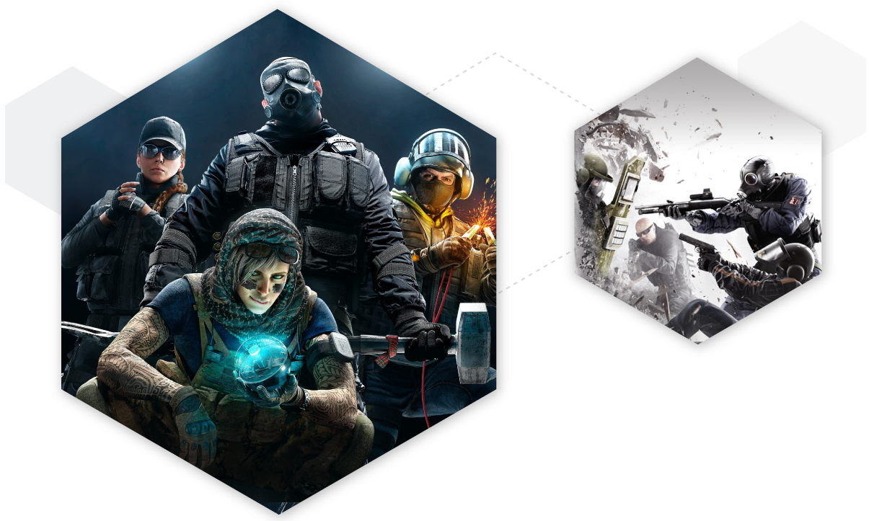
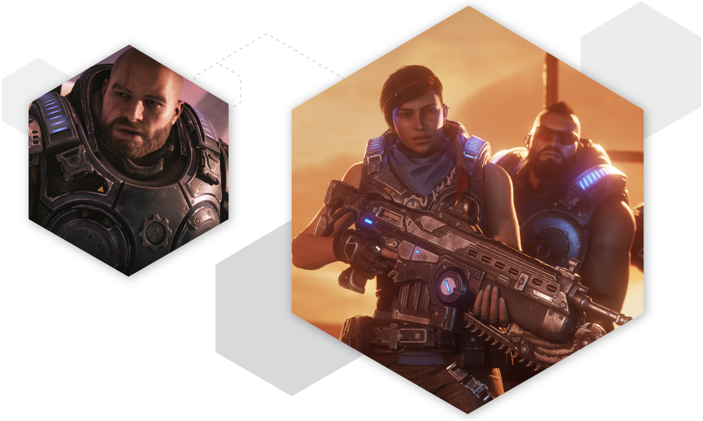

Azure PlayFab
Multiplayer Server Hosting
Elastic scale dedicated multiplayer game servers
Digital Economy
Process payments, manage virtual currency, sell catalog items, and guard against fraud
Telemetry Processing
Programmatic event stream ingestion & processing
Notes:
~1 min
Game studios use Azure PlayFab for building and operating their games. Many studios within Microsoft and outside rely on it for massive titles.
PlayFab is much more than what I have here, but I want to mention just 3 of the services within PlayFab that are using Orleans and in the interest of time, we’ll only discuss the first two there.
So let’s dive into PlayFab’s Multiplayer Server Hosting

Slide 84
Azure PlayFab Multiplayer Servers
Control plane for hundreds of thousands of VMs running game servers across many regions to optimize player experience
Ensures that a sufficient pool of VMs is always ready to handle new game sessions for each game configuration
Multiple control plane clusters for resiliency
Grains represent tenants, titles, deployments, pools, allocators, monitors, individual VMs
VMs send status heartbeats to control plane, control plane sends instructions to VMs
Co-host ASP.NET Core and Orleans for simplicity and improved performance & reliability, using .NET Generic Host
Notes:
~4 mins
PlayFab runs game servers for studios.
Spread over world for pings.
Up above it all: control plane that orchestrates them.
Control Plane built on Orleans
The model that a game developer sees is that they have a tenant, let’s say it’s 343i, and then they have a game, so call it Halo, then a deployment, which is a specific build of the game that might come with some game configuration.
And they configure how many VMs they want to keep ready for new game sessions, the number of VMs in that pool can change over time, depending on predicted load.
The control plane will make sure that there are enough VMs in a healthy, ready state for that game at any point in time. And at any point in time, there are hundreds of thousands of these VM cores running.
The control plane then has grains that represents those each of those concepts, like tenants, titles, deployments, VM pools, VM allocators, monitors and finally, individual VMs.
The VMs are all constantly sending heartbeats to the CP, and the CP keeps their status updated locally, and it takes VMs out of the pool when the game requests it, ready for players to connect.
Orleans clusters automatically detect failed nodes and recover from failures, but gamers really dislike outages, so there are multiple Control Plane clusters in different regions and if one of them has a network blip, then another can take over.
Clients calling into the Control Plane use HTTPS, and the control plane co-host the HTTP server in the same process as the silo, using the .NET Generic Host.
By co-hosting the HTTP frontend with Orleans, the frontend can directly call local grains without needing to make network calls.
When it does need to cross the network boundary, it has access to knowledge of the current state of the cluster, so it can avoid going through an additional gateway and instead calls are routed directly to where they’re needed. Avoiding network hops can significantly improve performance.
That was a recent change – the HTTP server used to be separate from Orleans. The change to merge them together into one process and gain that performance didn’t require changing application code. The only thing that changes was how the host was set up: to host a server instead of adding a client. That’s pretty cool.

Slide 85
Azure PlayFab Digital Economy
Helps game developers to monetize their games
Handles in-app purchases, virtual currency transactions, inventory management, coupons
Virtual currencies may be in-game, consumable items
Grains represent user accounts & wallets
Uses Orleans’ Distributed ACID Transactions across multiple grains
Runs on .NET Core in Linux containers on Kubernetes
Notes:
13 mins
~4 mins
The PlayFab Economy service, allows games to process payments, manage virtual currency, sell catalog items, and guard against fraud
Grains: accounts & wallets
Currencies: items, traditional currencies – Rubies in Minecraft Earth
When dealing with real money, you often want transactions to prevent exploits and unhappy players.
If you pay for something, you would be upset if you didn’t receive it.
The Economy service uses Orleans’ Distributed ACID Transactions for this.
Like the bank account example.
Custom storage: CosmosDB, w/ currency per doc
Custom participant: Event Hubs for transaction lifecycle messages, audit log
New, from MSR.
Beauty: fault tolerant
--- SKIP REST after 16:30
Scalable
###
Distributed Transactions are a rather new feature in Orleans, we built them with the help of Microsoft Research, and there’s a technical report you can read online about them, or message me if you’re curious how it all works.
The beauty is that thanks to Orleans being fault tolerant, and grains being virtual, the distributed transactions are also fault tolerant. So if a machine fails part way through a transaction, you’re not left in the lurch. The transaction can continue on another machine, and
It will probably be aborted depending on where in the process the failure happened, but life goes on.
--- SKIP REST after 16:30
Distributed Transactions are also scalable, and that’s one chief concern people raise about relying on transactions. If you have a transaction between you and a friend, that doesn’t need to coordinate with a transaction going on between two players you don’t know.
So it scales nicely. And your database doesn’t need to support transactions, either. You can run transactions over state stored in Azure Blob Storage for example.
Final thing on The Economy service. It’s all running on .NET Core in Linux containers, on Kubernetes.
###
Grains are used to represent user accounts and wallets. Each wallet can have many currencies in it. The currencies could represent individual items in the game, or things that we consider more traditional currencies, like Rubies in Minecraft Earth.
The wallet grains use a custom storage provider that stores each currency into separate documents in Cosmos DB so that you’re only updating documents that need updating.
And they also emit an event on Azure Event Hubs for when the transaction is prepared and aborted or committed. That way, the transaction lifecycle messages are tracked somewhere for auditing purposes.

Slide 86



Notes:
16:30
~1.5 mins
Halo is probably the most well-known app using Orleans, so multiple halo titles rely on Orleans-based services
And multiple Gears is running Orleans, too.
For the Halo case, they built services for tracking players in near-real-time, performing detailed analytics on the game matches.
They also do cheat detection, to try to detect modded consoles for example or detect griefers in the game, as well as content management services
For the analytics, they use Orleans streams via EH to reliably incorporate what happens in every match into the player’s profile.
For Gears, The Coalition, up in Vancouver, also use grains to create a lobby service.
Other studios outside of MS also build lobbies.
Caitie McCaffrey’s talks

Slide 87
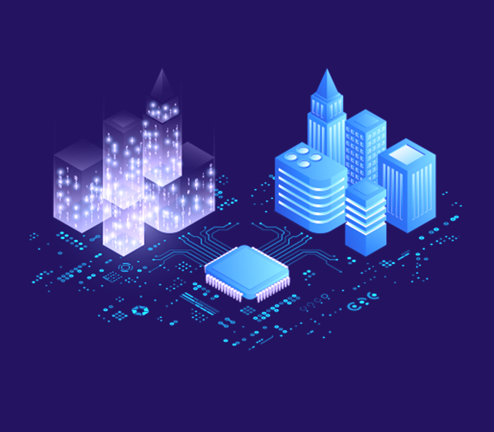
Azure IoT Digital Twins
Digital replicas of real-world things: sensors, rooms, lights, air conditioning systems, elevators
Model relationships between physical entities to create a twin graph
Grains model twins generically so that end-users can prescribe meaning
Reminders for reliability
Programmability via Azure Functions
Notes:
18 mins
~2 mins
We talked about what gaming teams have done with Orleans. You can take those use cases and apply them to other domains, but because this is about concrete uses of Orleans at Microsoft, we should of course talk about Azure and other teams and what they’ve built.
Azure IoT uses Orleans in their Digital Twins offering.
Classic use case: IoT
Digital Twin of real thing.
Allows users to create graphs of twins.
Not just a big soup of devices, they create relations and query.
Bi-directional links b/w grains
For reliability, they use Reminders for this.
Reminders are durable timers, like cron jobs, but scoped to a grain.
Set reminder to ensure both grains make the link.
If failure? Well, reminder fire again soon.
###
Now this is a classic kind of use case for Orleans, because IoT is the Internet of Things, and each thing can be mapped rather nicely to a grain.
In this case, you have "digital twins” of your real-world objects, so you have grains that represent devices like sensors and thermostats and then you can monitor them and program them and work with them using their digital representation, and any changes you make can be mirrored back to their physical representation, and vice versa.
They map relationships between the different devices and effectively create a graph. Eg, you might have all devices in the same physical room be linked to each other using graph edges to model that relationship.
They didn’t need full-fledged ACID transactions for that linking, so they use a different approach. When you create a link, there’s a reminder that’s created. A reminder is kind of durable timer, like a cron job, but scoped to a grain.
The reminder ensures that both grains eventually persist the link. If a machine is taken down part way through, that’s ok because the reminder will fire again soon and the link can be completed. Of course, machines going down is pretty rare, but rare things happen frequently when you’re at scale, so you have to design for resiliency.

Slide 88
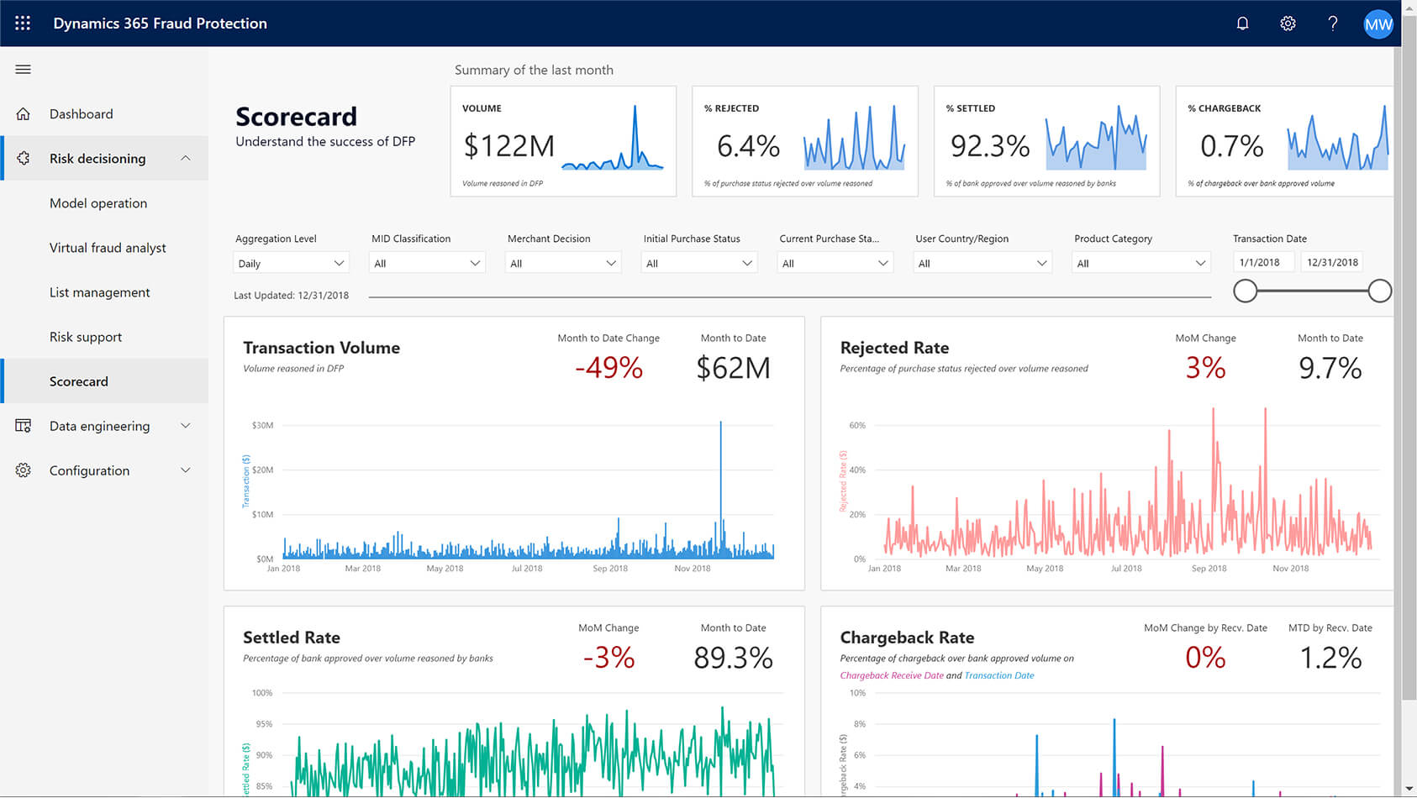
Dynamics 365 Fraud Protection
Detect fraudulent purchases and account usage, and more
Model business workflows, capture events, and analyze events using AI
Grains represent users, jobs, standing queries, classifiers
Geo-distributed for performance, resiliency
Notes:
21 mins
~2 mins
Dynamics 365 Fraud Protection helps businesses detect and protect against fraud. Things like account logins, eCommerce purchases, bots. Using AI.
Ex: eCommerce
Builds up a profile for a user over time.
Run analytics on demand to detect fraud as it’s happening
Other companies have also used Orleans for user identity-based applications to great success.
Eg Gigya acquired by SAP
--- SKIP after 22 mins
Globally distributed. Some types of grains can roam between clusters.
Custom plugin and some modification.
Interesting things can be done.
###
So the general flow is that there are all of these events coming in, and they are related to some context. Take eCommerce, for example, you have users that make purchases, etc, and when they do that, they have an IP address and shipping and billing addresses, etc, associated with that, and credit card info. So you can start to build up these graphs and spot anomalies. That’s my rudimentary understanding of it.
Anyhow, so that context – a user or whatever – maps to a grain, and you link to their history from there.
This system is globally distributed.
The team behind it has implemented a novel geodistribution system. They have geographically separated clusters and they're using the new pluggable grain directory feature that we just released, and some other modifications, to allow some grains to be located anywhere in their global set of clusters while still making them accessible from any of their clusters. So you can’t trick the system by doing one thing using one IP and then another thing using an IP on another side of the world.
---

Slide 89

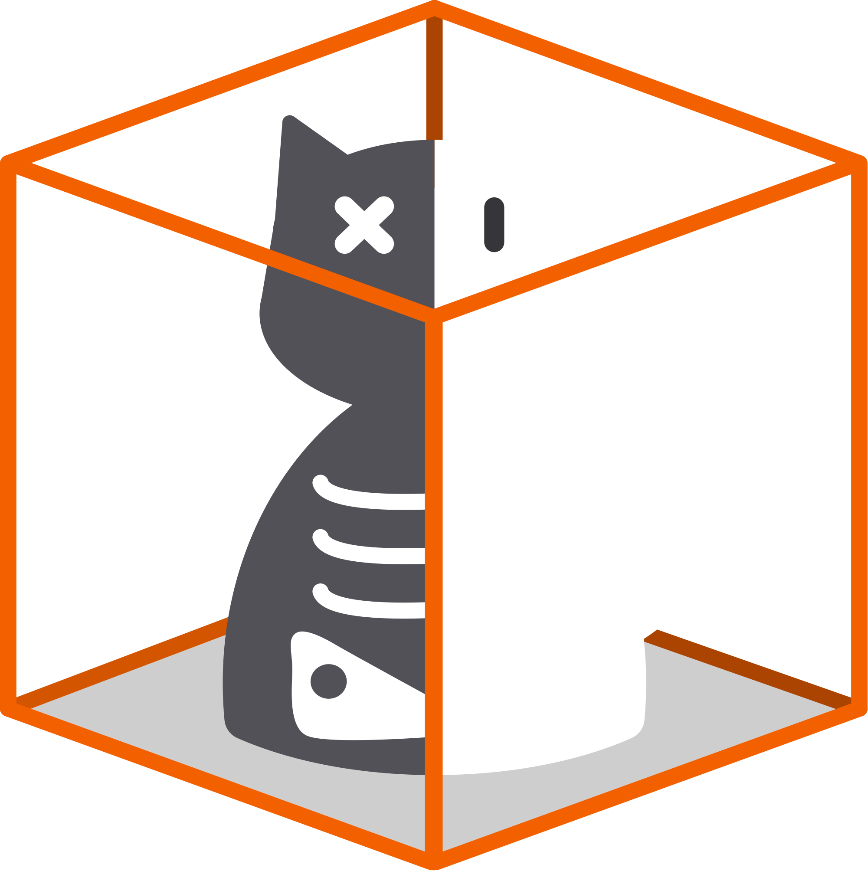
Azure ML
Azure Quantum
Design, train, serve machine learning models
Job scheduling
Resource management
Grains represents tenants, jobs, reliable workflows, provisioning
Execute quantum computing jobs on special hardware in Azure
Job scheduling
Resource management
Grains represents tenants, jobs, results
Notes:
23 mins
~1 min
I combined Azure Machine Learning and Azure Quantum because I want to mention them both, and their use cases are similar.
Azure ML runs several services on Orleans, so this is just some of what they do here, but the service as a whole lets you design, train, and serve ML models.
Azure Quantum allows users to submit jobs that then get run on special hardware and simulators, so they can run experiments.
In both cases, you have some special hardware and you want to maximize use of it. So they have Job scheduling systems built on Orleans, using those Reminders again, for reliability.

Slide 90
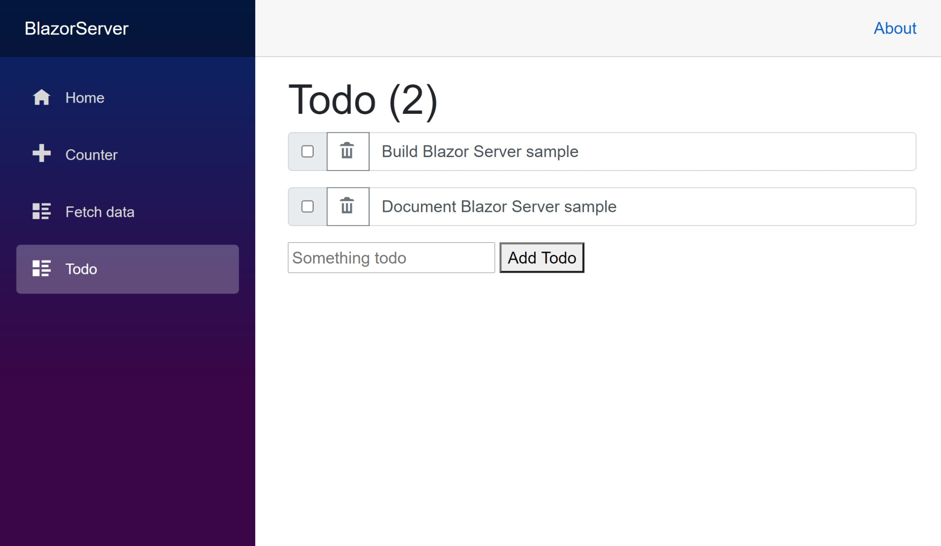
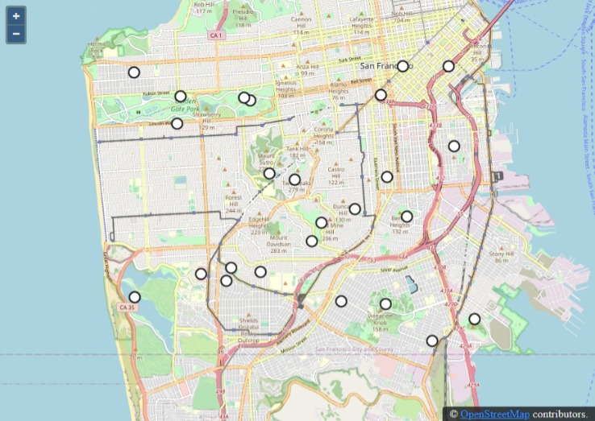
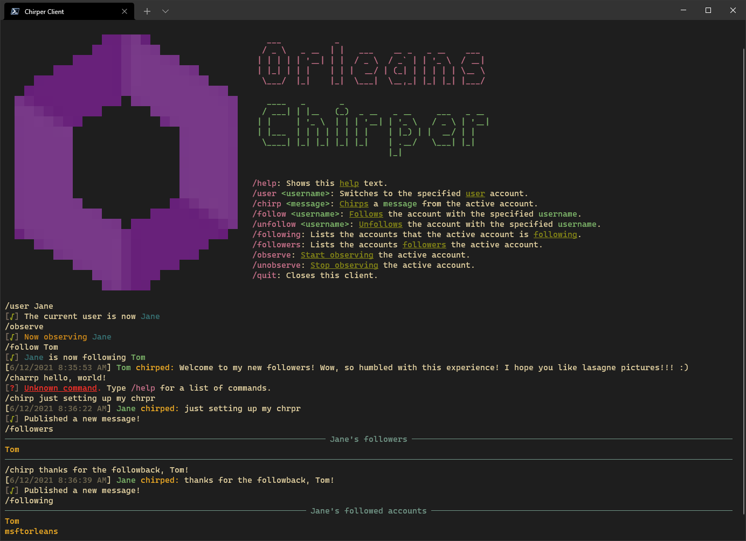
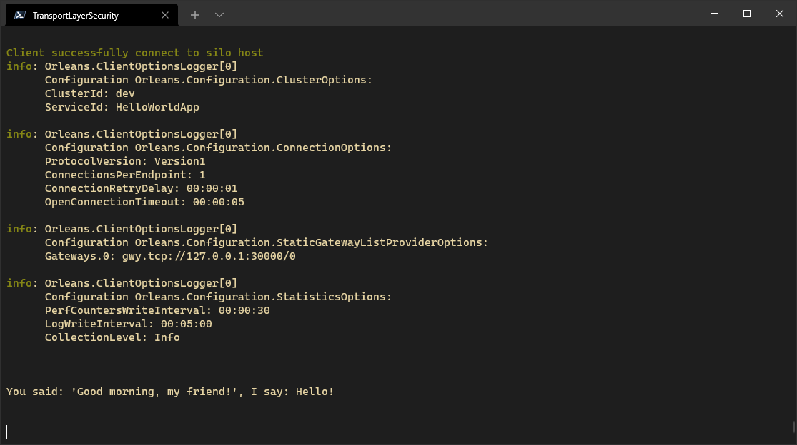
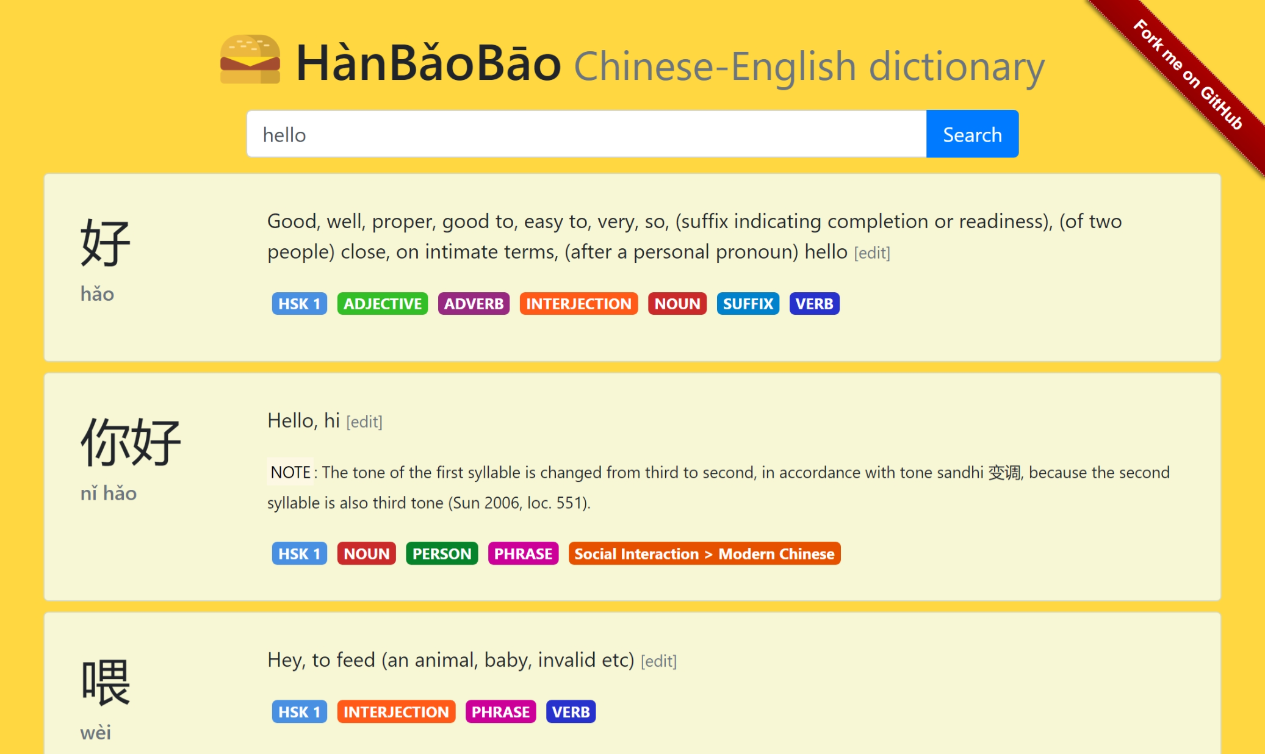
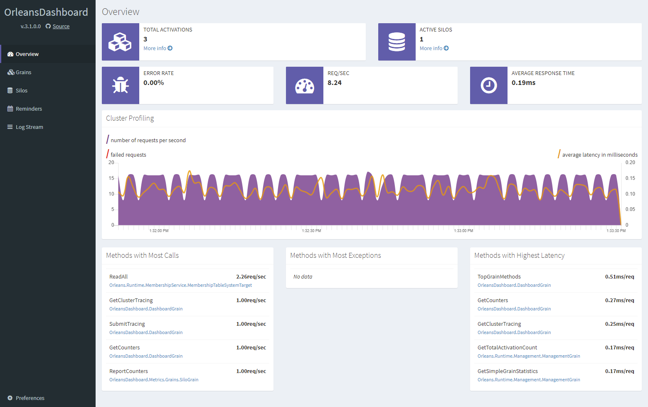
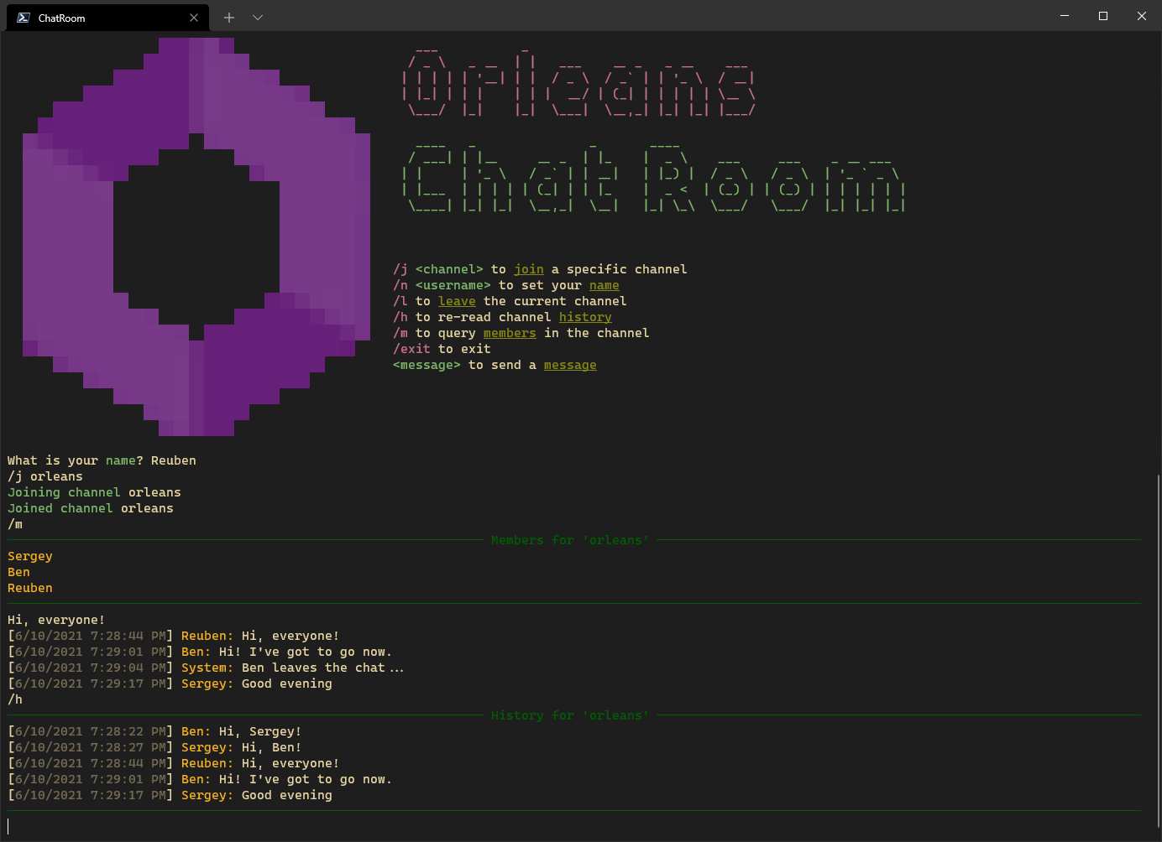
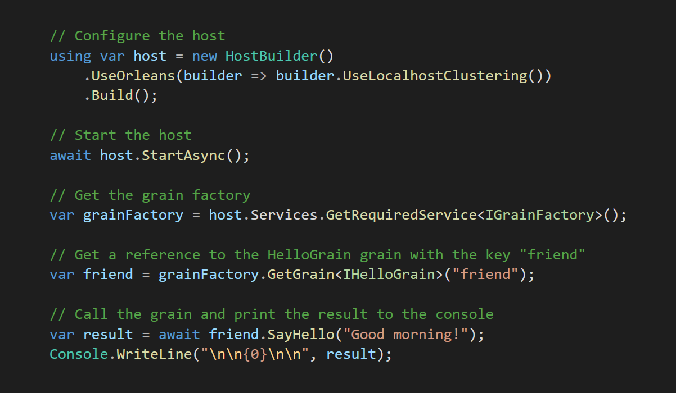
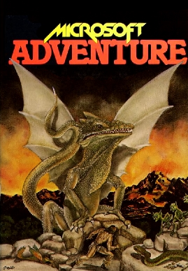
https://aka.ms/orleans-samples

Slide 91
Break: 15 minutes

Slide 92
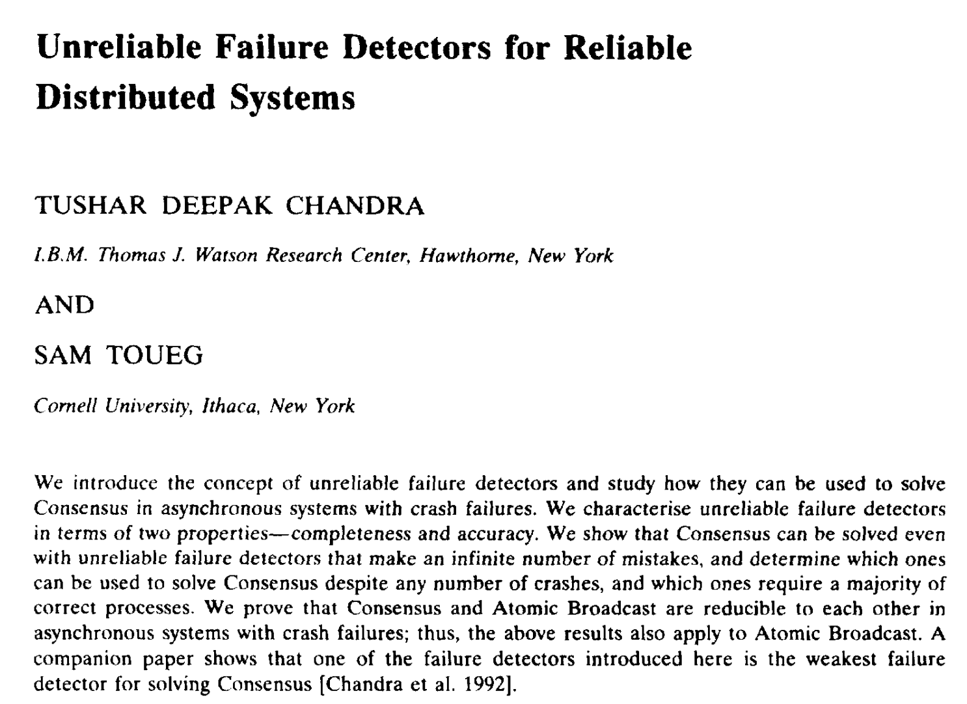
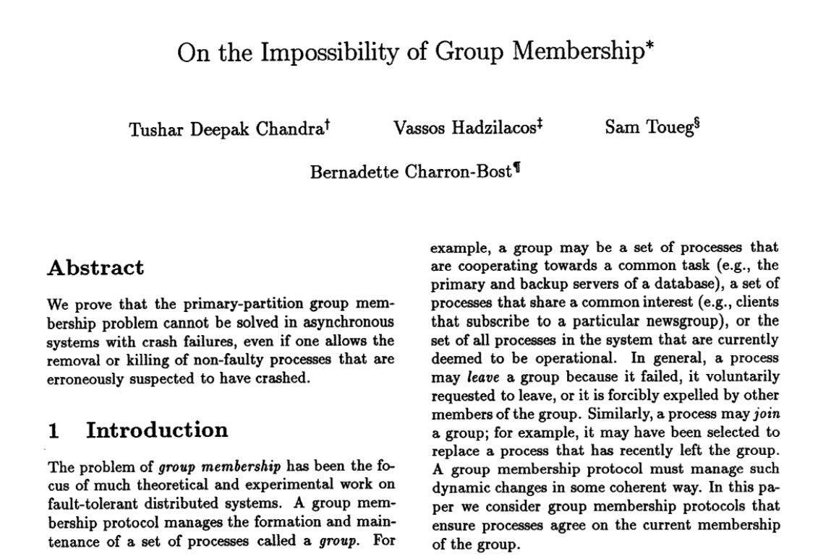
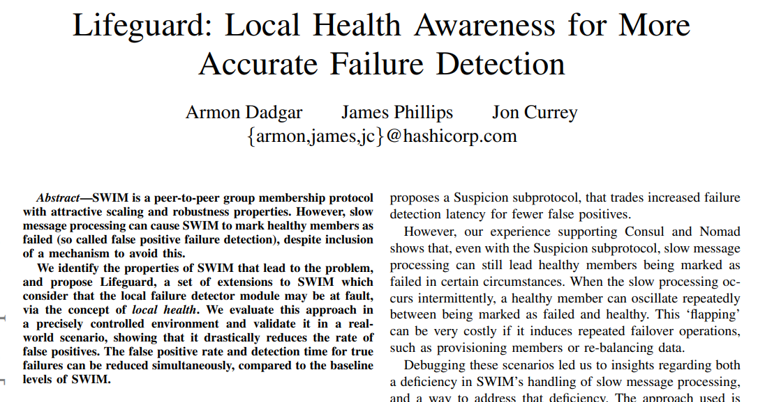
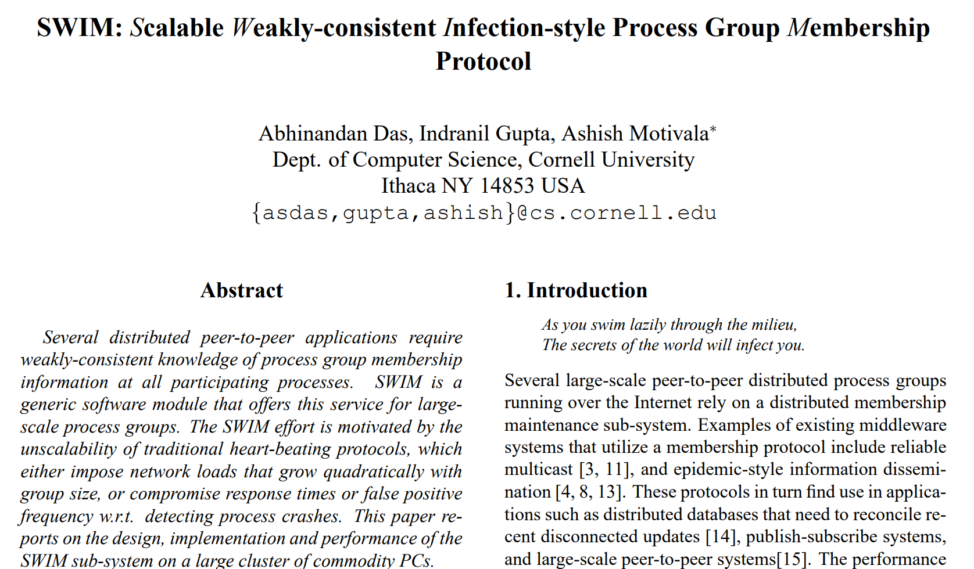
Clustering resources

Slide 93
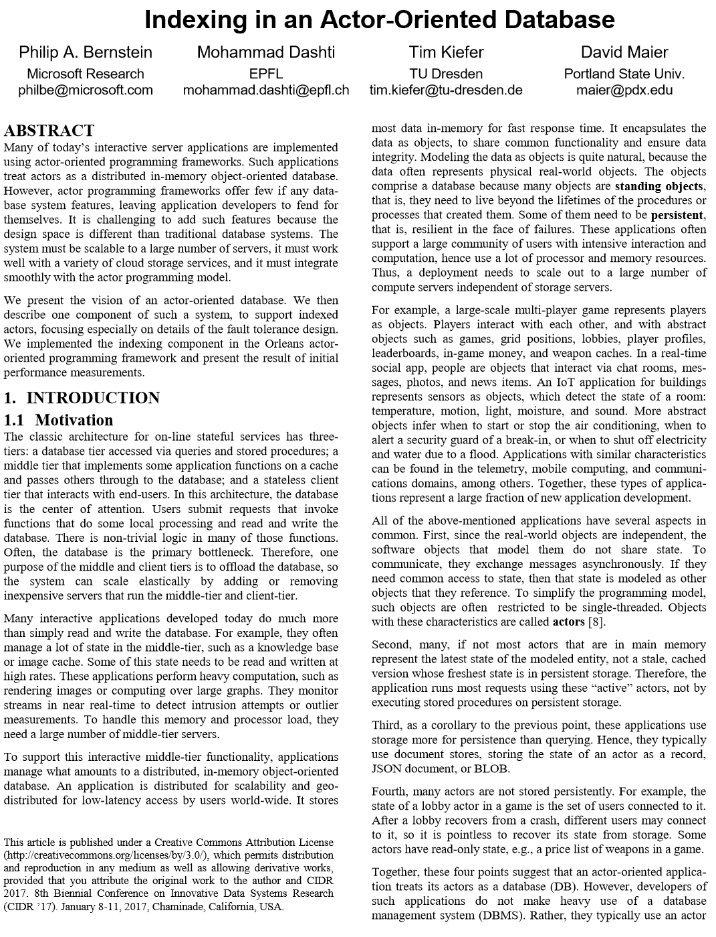
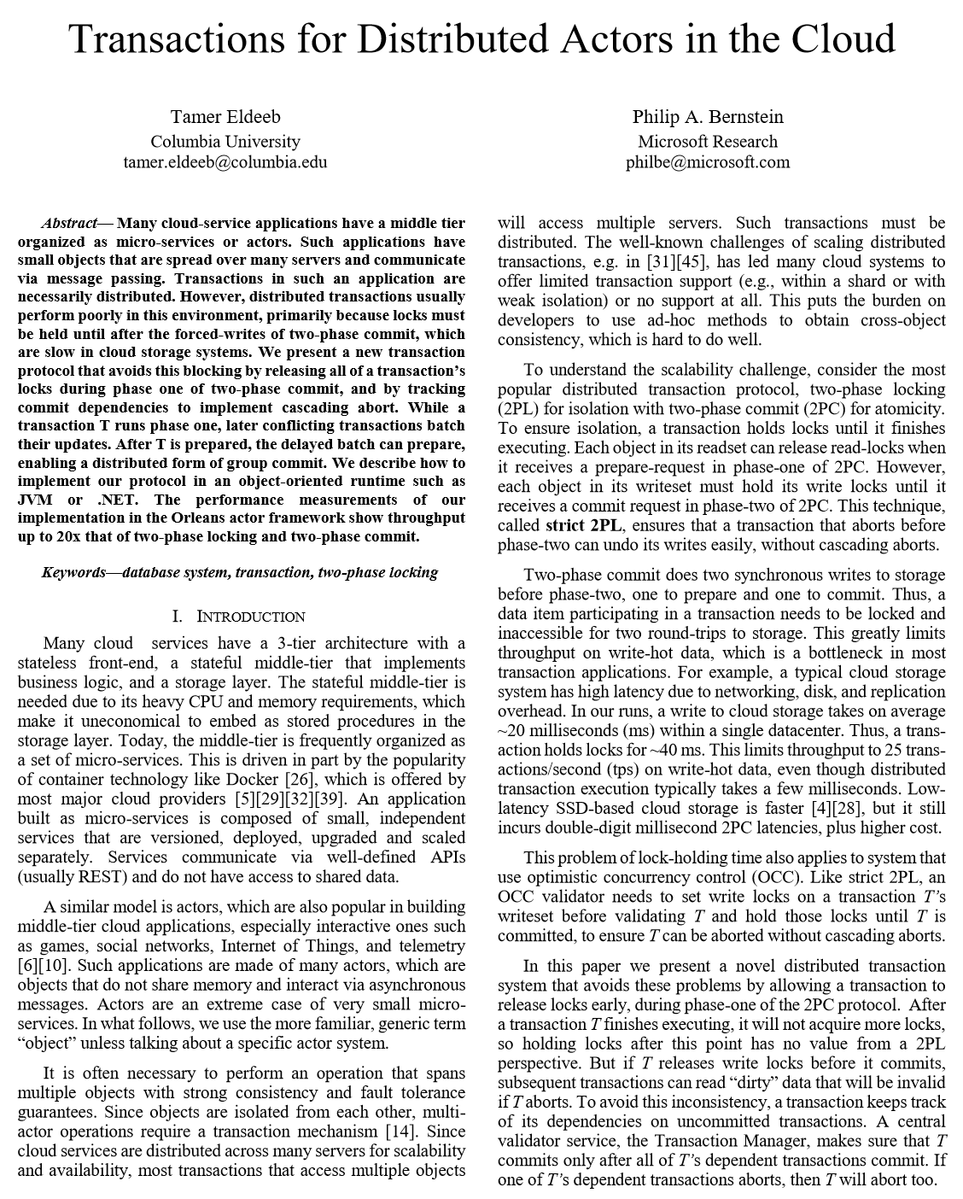
https://aka.ms/orleans-indexing
https://aka.ms/orleans-txns

Slide 94
Orleans’ Approach to Distributed Compute
Familiar OOP-like programming model
Directly interacting stateful ‘objects’
Transparent distribution and lifecycle
Encapsulation of proven patterns
Stateful and stateless compute
No need to learn complex concepts
Simple but powerful
Scalable by default
Up to 10 times less code to write
Frontends
Actor-based Middle Tier
Storage

Slide 95
Motivation / Problem
Developer productivity in the Cloud
Familiar concepts
Write much less code
‘Boilerplate’ concerns covered by the runtime
Scalability by default
Avoid typical anti-patterns
Encapsulate proven patterns

Slide 96
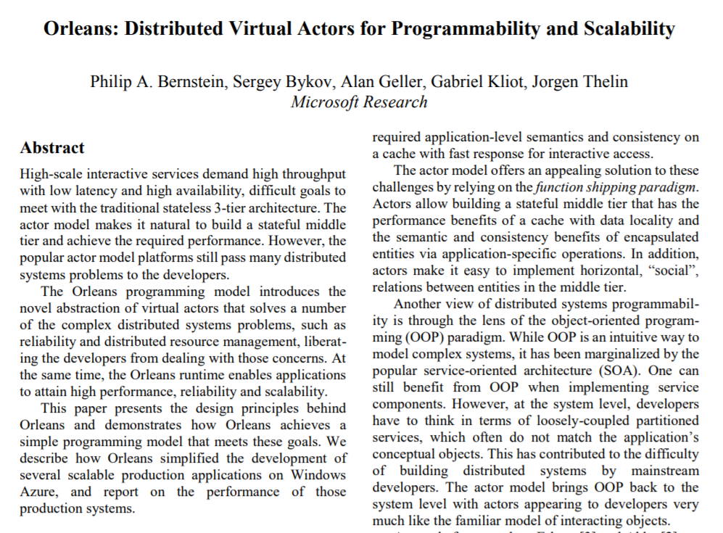
Grains
Fundamental building block
Virtual Actor
Effectively: Distributed Object
Unit of computation + state
Send/receive messages
React to incoming messages
https://aka.ms/orleans-paper-2014

Slide 97
Grains
Model objects in domain
IoT device twins, user profiles, game sessions, auction items, blog posts, …
Create graphs for computation/communication
Fan-out, Fan-in & other processing patterns
Concurrent workers, caches
Distributed system realities
Select an appropriate granularity
Notes:
What do you use grains for?​
​
Generally 2 things.​
1st: domain objects​
Give example​
​
2nd computation, scaling out work, reducing pressure on hot grains, caching, etc​
​
DS realities​

Slide 98
in-memory, persisted, or stateless
User/fabio
grain = identity + behavior [+ state]
class User : Grain, IUser

